Slide 1
Kitchen Safety
8th Grade FACS

Slide 2
Safe or
Un Safe
Multi Choice
Completion
Short Answer
100
100
100
100
100
200
200
200
200
200
300
300
300
300
300
400
400
400
400
400
500
500
500
500
500
Double Jeopardy

Slide 3
Will plugged the cord into the outlet first and then into the frying pan
Answer
unsafe
Notes:
seasoning

Slide 4
When Allison plugged in the toaster, she made sure nothing else was plugged into that outlet
Answer
safe
Notes:
mince

Slide 5
Kali checked to make sure the floor was dry where she was standing to work with the blender
Answer
safe
Notes:
creaming

Slide 6
After he spilled gravy on the power cord, Adam rinsed the cord off right away
Answer
unsafe
Notes:
Cut in

Slide 7
Joanna pulls on the cord to unplug the mixer from the outlet
Answer
unsafe
Notes:
Fold

Slide 8
Trisha thaws chicken in a covered bowl on the counter
Answer
unsafe

Slide 9
Bridgette washes her hands, the counter and all utensils in hot, soapy water when she is done working
Answer
safe

Slide 10
Gabriel cuts up raw chicken on a wooden cutting board.
Answer
unsafe

Slide 11
Gerald makes sure his chicken is cooked thoroughly
Answer
safe

Slide 12
Lori uses one dish to carry the raw chicken to the grill and a second to carry the cooked chicken from the grill
Answer
safe

Slide 13
All of the following statements are good general safety tips EXCEPT
A. use a step stool or ladder
B. unplug the garbage disposal before reaching in
C. close cabinet doors when not in use
D. let spills dry on the floor so you don’t slip
Answer
D

Slide 14
Do all of the following EXCEPT what when using appliances?
A. rinse food before putting into hot fat
B. lift the far side of the pan so the steam does not burn you
C. turn handles of cooking utensils inward on the stove
D. unplug small appliances when not in use
Answer
A

Slide 15
All the following are good tips to prevent poisoning EXCEPT
A. keep household cleaners where children cannot reach them
B. do not mix cleaners together
C. keep the number for poison control on a piece of paper by the chemicals
D. keep cleaners in their original packages
Answer
C

Slide 16
All of the following are good safety tips EXCEPT
A. wash knives separately
B. keep knives somewhat dull so you won’t get cut
C. store knives separately from other utensils
D. use a cutting board – not your hand – when chopping food
Answer
B

Slide 17
All of the following make for good teamwork EXCEPT
A. make a team plan
B. do all the tasks in order, one at a time
C. estimate how long each job will take
D. divide the jobs fairly
Answer
B

Slide 18
Food poisoning is called also called a(n) _______ illness
Answer
FOOD-BORNE

Slide 19
Keeping bacteria down to as little as possible, to maintain a clean condition is called ___________?
Answer
SANITATION

Slide 20
_______ tasks are those you need to do before combining the ingredients
Answer
PRE-PREPARATION

Slide 21
The range of temperatures within the Danger Zone where bacteria grow rapidly
Answer
60-125

Slide 22
The _______ is the world around you
Answer
Environment

Slide 23
Bacteria need three things to grow… name two.
Answer
FOOD, MOISTURE, WARMTH

Slide 24
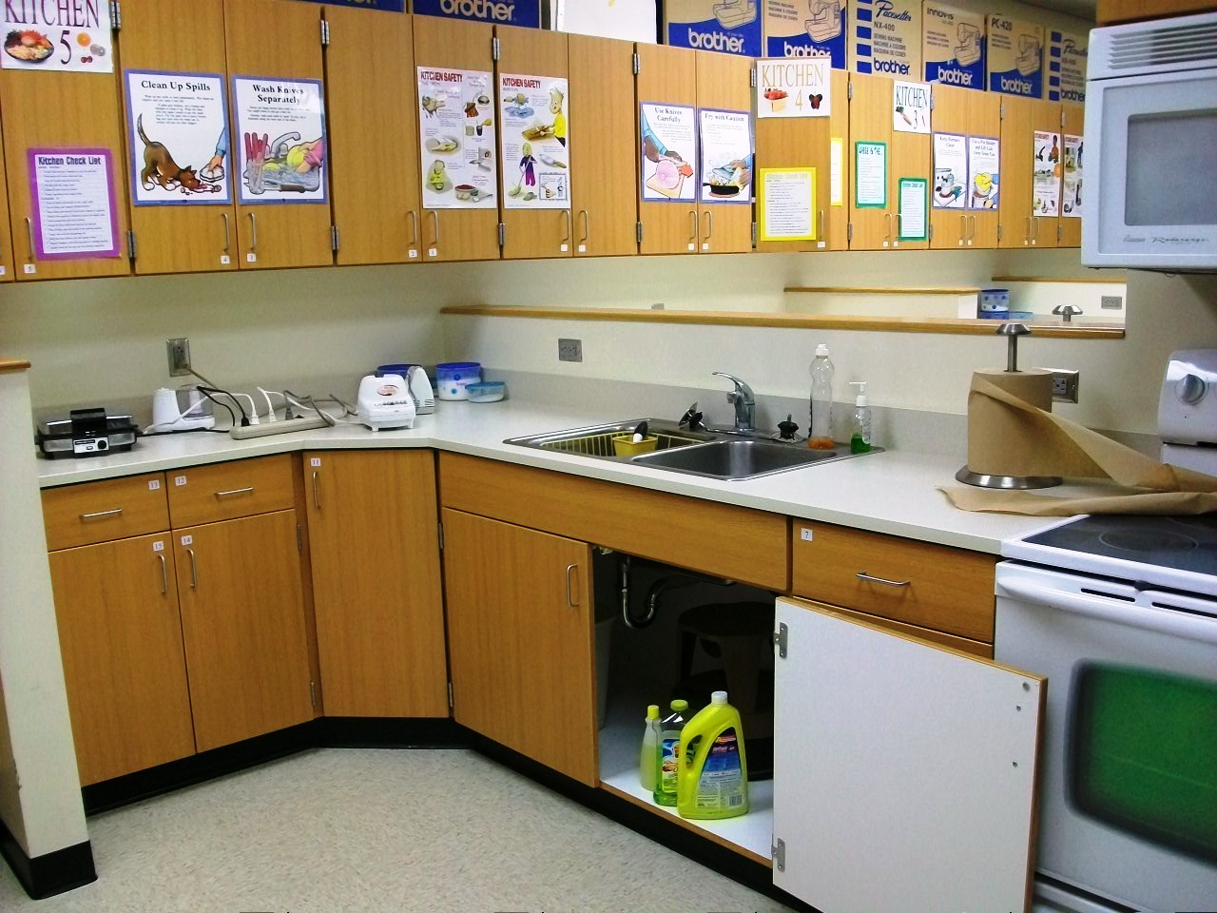
Find 3 potential hazards within the image.
Answer
Cabinet open, cleaning supplies, paper towels, too many appliances plugged in, appliances close to edge

Slide 25
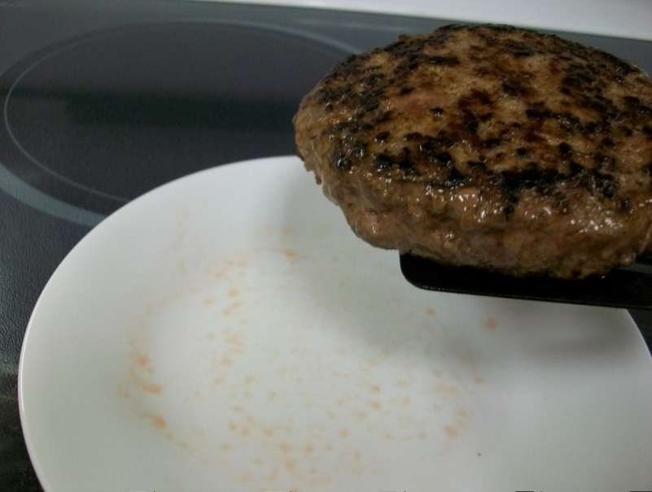
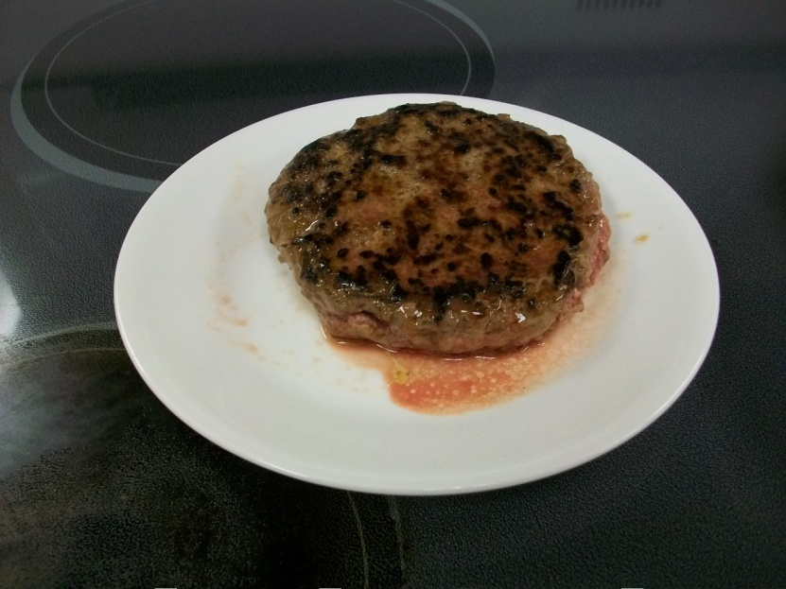
Picture A
Should you put the burger on the plate? Why or why not
Picture B
Should you eat this burger? Why or Why not
Answer
A – No the plate is dirty, cross contamination, had raw meat
B – No its not fully cooked – juices are red not clear

Slide 26
Why is planning a schedule important when preparing an entire meal or in a lab setting
Answer
SO EVERYTHING IS DONE ON TIME

Slide 27
What are 2 general guidelines for preventing accidents when working in the kitchen
Answer
THINK AHEAD AND WORK SAFELY

Slide 28
Vocab
Vocab
Vocab
Vocab
Accidents
200
200
200
200
200
400
400
400
400
400
600
600
600
600
600
800
800
800
800
800
1000
1000
1000
1000
1000
Final Round

Slide 29
Chilling or freezing food for preservation
Answer
REFRIGERATION

Slide 30
Maintaining a clean condition – not personal
Answer
SANITATION

Slide 31
A bacteria associated with improperly canned foods.
Answer
CLOSTRIDIUM BOTULINUM

Slide 32
The spreading of germs from one surface to another
Answer
CROSS-CONTAMINATION

Slide 33
Foods that spoil easily are know as this
Answer
PERISABLE

Slide 34
The infection that comes from eating or drinking contaminated food or water
Answer
FOOD POISONING

Slide 35
A bacteria associated with contaminated water, raw milk, and raw or undercooked ground beef.
Answer
E. COLI

Slide 36
Temperatures at which bacteria grow rapidly
Answer
FOOD DANGER ZONE

Slide 37
Growth of germs in the body of a human or animal
Answer
INFECTION

Slide 38
Tasks done before you combine ingredients
Answer
PRE-PREPARATION

Slide 39
Overlapping tasks to assure completion at the same time
Answer
DOVETAIL

Slide 40
Microscopic life not seen by the un-aided eye
Answer
MICROORGANISM

Slide 41
Single-cell microorganisms, good ones make yogurt and medicine
Answer
BACTERIA

Slide 42
Destroying microorganisms by heat
Answer
PASTEURIZATION

Slide 43
A bacteria associated with undercooked foods especially poultry and eggs.
Answer
SALMONELLA

Slide 44
Practices like hand washing that promote good personal health
Answer
HYGINE

Slide 45
The kind of accident that can result from too much heat and oily foods
Answer
GREASE FIRE

Slide 46
Food, Money, Time, Energy, and Fuel are all examples of
Answer
RESOURCES

Slide 47
A bad microorganism
Answer
GERM

Slide 48
Last calendar date to use a food product
Answer
EXPIRATION DATE

Slide 49
Three ways to prevent falls
Answer
VARIOUS

Slide 50
Three ways to prevent cuts
Answer
VARIOUS

Slide 51
Three ways to prevent burns and fires
Answer
VARIOUS

Slide 52
Three ways to prevent electric shocks
Answer
VARIOUS

Slide 53
Three ways to prevent poisoning
Answer
VARIOUS

Slide 54
Random
A B C D E
100
100
100
100
100
200
200
200
200
200
300
300
300
300
300
400
400
400
400
400
500
500
500
500
500

Slide 55
The three secondary colors
Answer
Green, Orange, Violet (Purple)
Notes:
seasoning

Slide 56
The 4 superheroes in the Fantastic Four
Answer
Human Torch, Invisible Woman, Mister Fantastic, Thing
Notes:
mince

Slide 57
What are the three names of the Rice Krispies elf mascots
Answer
Snap, Crackle, Pop
Notes:
creaming

Slide 58
4 families of instruments in a symphony orchestra
Answer
Brass, Percussion, Strings, Woodwinds
Notes:
Cut in

Slide 59
What are the names of the four Ninja Turtles and who are they named after?
Answer
Donatello, Leonardo, Michelangelo and Raphael - Painters
Notes:
Fold

Slide 60
5 National Football teams that have a bird in their name?
Answer
Seattle Seahawks, Arizona Cardinals, Philadelphia Eagles, Atlanta Falcons, Baltimore Ravens

Slide 61
5 family members on the Simpsons
Answer
Homer, Marge, Bart, Lisa, Maggie

Slide 62
6 words represented in the acronym NASCAR
Answer
National Association of Stock Car Auto Racing

Slide 63
7 consonants on the keyboard’s bottom row
Answer
Z X C V B N M

Slide 64
5 colors of the Olympic Rings
Answer
Black, Blue, Green, Red, Yellow

Slide 65
2 of the 3 Nations that begin with the letter J
Answer
Japan, Jamaica, Jordan

Slide 66
5 U.S. states that border the Gulf of Mexico
Answer
Texas, Louisiana, Mississippi, Alabama, Florida

Slide 67
4 of the 6 Boy Scout ranks
Answer
Tenderfoot, Second Class, First Class, Star, Life, Eagle

Slide 68
5 U.S. military branches
Answer
Army, Navy, Air Force, Marines, Coast Gaurd

Slide 69
6 of the 9 U.S. state capitals with more than one word in their name
Little Rock, Des Moines, Baton Rouge, St. Paul, Jefferson City, Carson City, Sante Fe, Oklahoma City, Salt Lake City
Answer

Slide 70
Washington DC holds a cherry blossom festive in late March early April. What color are cherry blossoms?
Answer
Pale pink

Slide 71
8 things swallowed in the children’s rhyme There Was an Old Lady Who Swallowed a…
Answer
Fly, Spider, Bird, Cat, Dog, Goat, Cow, Horse

Slide 72
8 Crayola colors in the first box produced in 1903
Answer
Black, Brown, Orange, Violet, Red, Yellow, Green, Blue

Slide 73
5 of the 7 categories in the classification of living things
KPCOFGS
Answer
Kingdom, Phylum, Class, Order, Family, Genus, Species

Slide 74
The 7 continents
Answer
Africa, Antarctica, Asia, Australia, Europe, North America, South America

Slide 75
How many cents does it cost the US mint to produce a nickel (within one)
Answer
9 cents

Slide 76
The first ten words of “The Star Spangled Banner”
Answer
Oh Say Can You See By The Dawn’s Early Light

Slide 77
5 main types of precipitation
Answer
Rain, Snow, Sleet, Freezing Rain, Hail

Slide 78
The 8 planets in the solar system
Answer
Mercury, Venus, Earth, Mars, Jupiter, Saturn, Uranus, Neptune

Slide 79
7 of the 9 characters in A Charlie Brown Thanksgiving
Answer
Charlie Brown, Sally Brown, Lucy van Pelt, Linus van Pelt, Peppermint Patty, Marcie, Franklin, Snoopy, Woodstock

