Slide 1
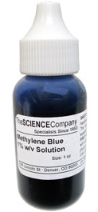
Blue’s the Clue
Module 3: Processing and Transportation
Screen shots have been take from:
Science and Our food Supply Curriculum - Middle School Edition

Slide 3
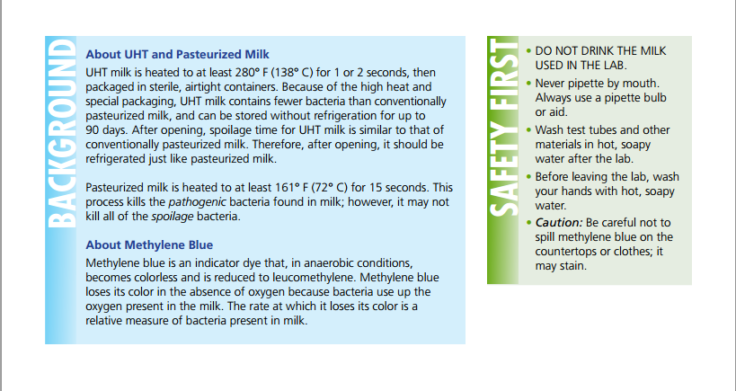

Slide 7
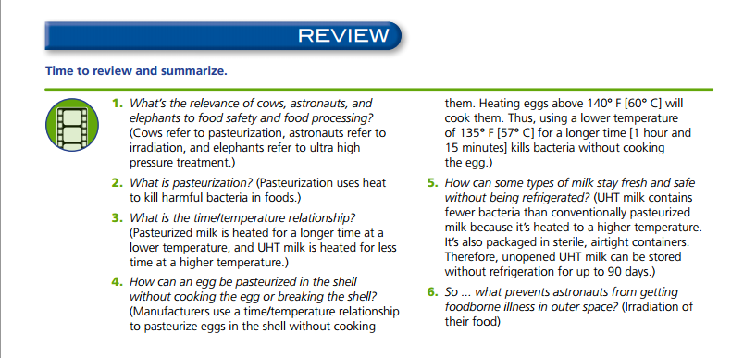

Slide 8
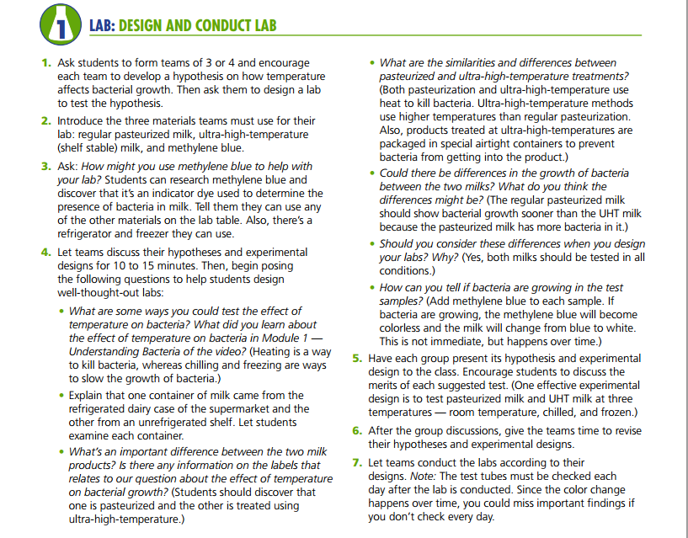

Slide 13
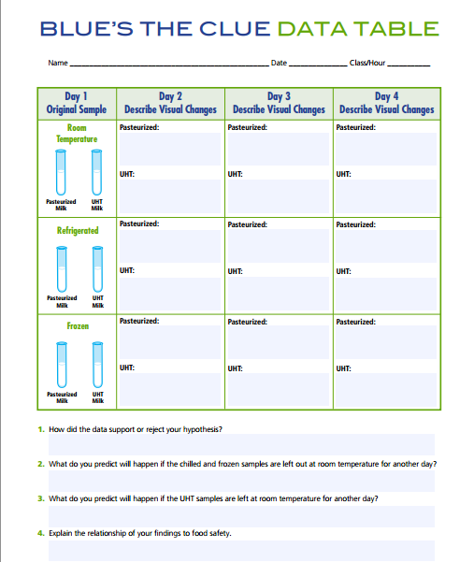

Slide 14
Variations
Assigned Step-by-Step Instructions
Students are placed into groups and then assigned a group position.
Lab steps are broken down into one step actions that are accomplished by specific group members.
Everyone must participate to make the lab effective.
Samples are taken from a central classroom location – rather than each individual group stations
Less milk is needed
Fewer sterile pipets are needed
Methylene Blue is supervised during the adding
Different Milk Samples
Purchase 2 identical cartons of pasteurized milk
Store one carton properly and one carton at room temperature for at least 48 hours – then re-refrigerate
Students do not know which carton is which before testing.
UHT Milk, 1%, 2%, Whole, Skim, Powdered (rehydrated), gallon jug vs. lunch carton size, home pasteurized, soy, rice, almond, goat
Raw????

Slide 15
Standards
Standards: Middle School
6-8.RST.3 Follow precisely a multistep procedure when carrying out experiments, taking measurements, or performing technical tasks
NW 3.1 Explain common practices that promote sanitary food conditions.
Standards: High School
9-12.RST.3 Follow precisely a complex multistep procedure when carrying out experiments, taking measurements, or performing technical tasks attending to special cases or exceptions defined in the text.
NW 2.1 Apply practices to promote safe food handling.
FT 2.1 Determine the steps in the scientific method and demonstrate its use in scientific experimentation.
FT 4.1 Recognize practices and procedures that minimize the risks of food borne illness

Slide 16
Potential Problems
Staining – Methylene Blue WILL stain clothing, countertops and SKIN! Excessive contact on skin can be potentially hazardous – gloves are highly recommended for the handling of this product
Good news: Methylene blue is relatively inexpensive and you will need to dilute it for use in this lab – so one bottle will ast for quite some time.
Sterile Pipets – In order to ensure that samples are not contaminated the lab calls for sterile pipets to draw the milk samples. These are one-use items.
Rather than have each group have a separate set of pipets – have one pipet per milk sample container that stays in the container until all the samples have been drawn - (I know, not proper science lab procedure, but the lab will still be effective)
Accessibility to UHT milk – depending on your location, Walmart stocks this with the baking products, can be purchased from Amazon
Results – it can take anywhere from 12 to 36 hours (especially if you do not incubate) for visible changes. In order for your students to view results, perform the experiment early in the week or photograph results over a weekend.

Slide 17
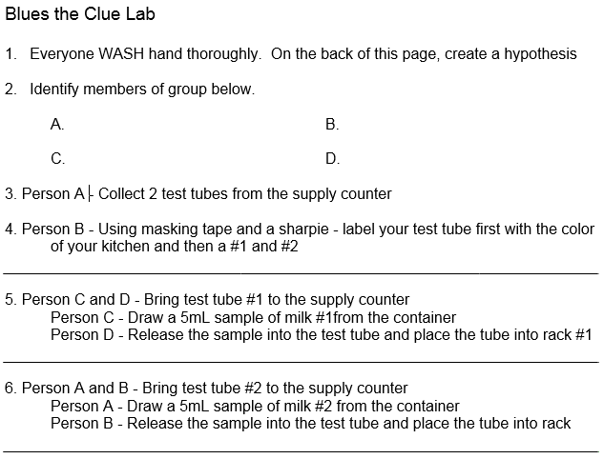
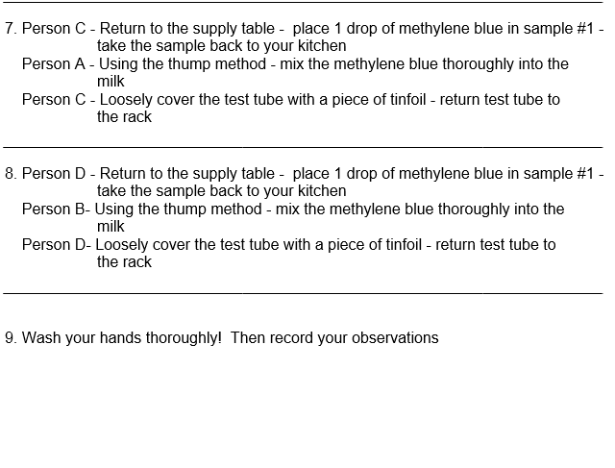
Blue’s the Clue Modified Lab – 6th Grade

Slide 18
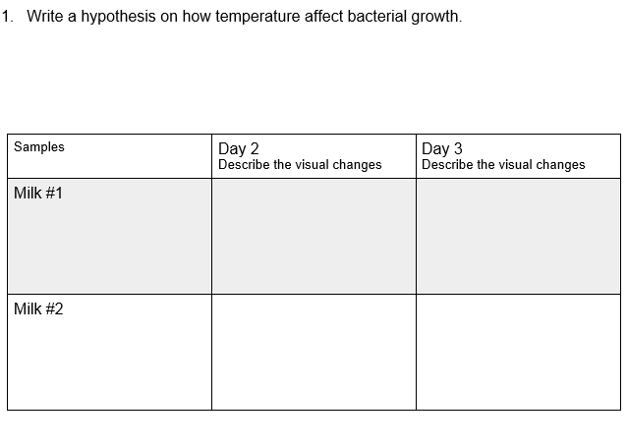
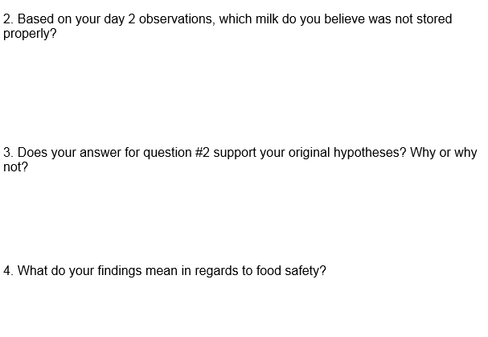
Blue’s the Clue Modified Lab – 6th Grade

Slide 19
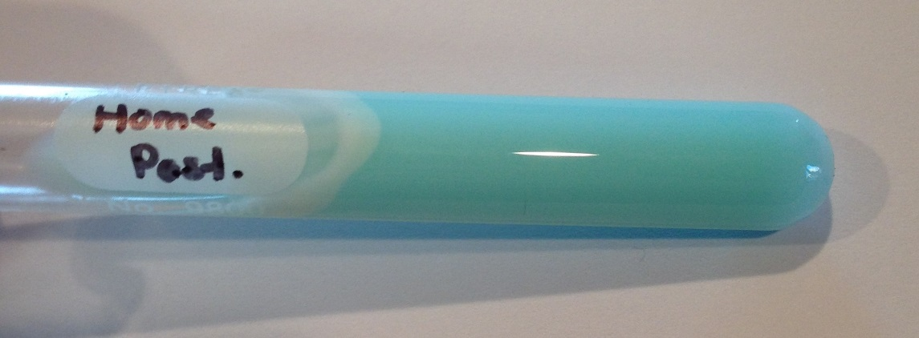
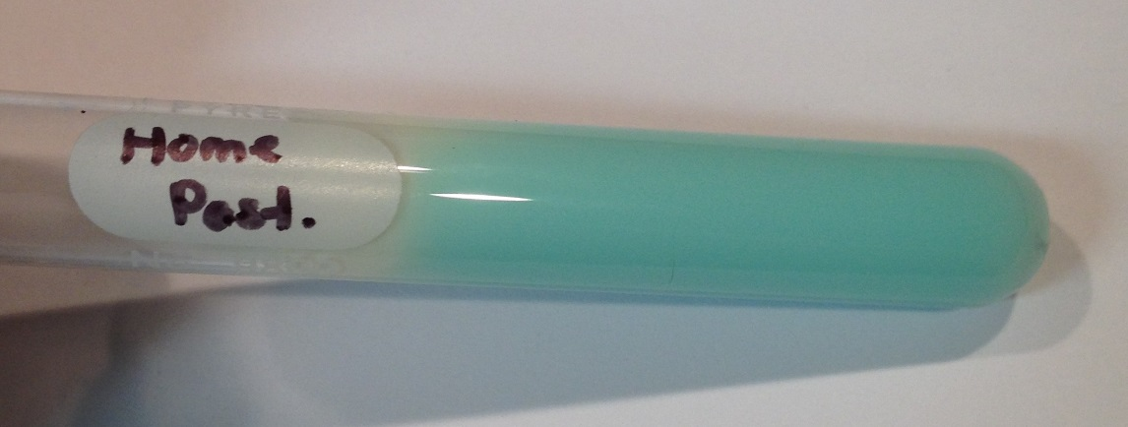
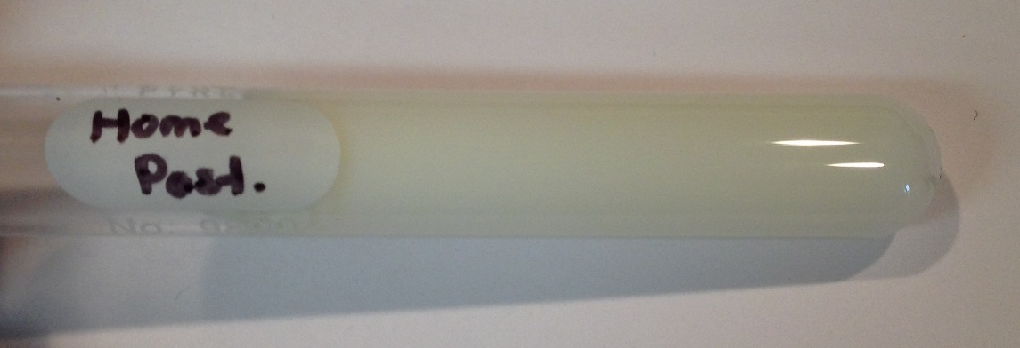
Home Pasteurized milk 1 day old – stored at refrigerator temperatures after pasteurization
Immediately after the application of methylene blue
12 hours at room temperature
24 hours at room temperature
36 hours at room temperature
-sample is still liquid

Slide 20
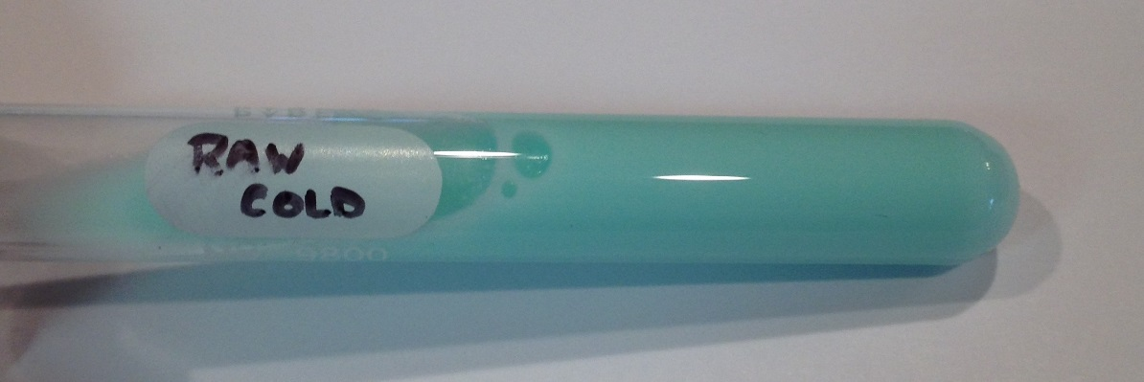
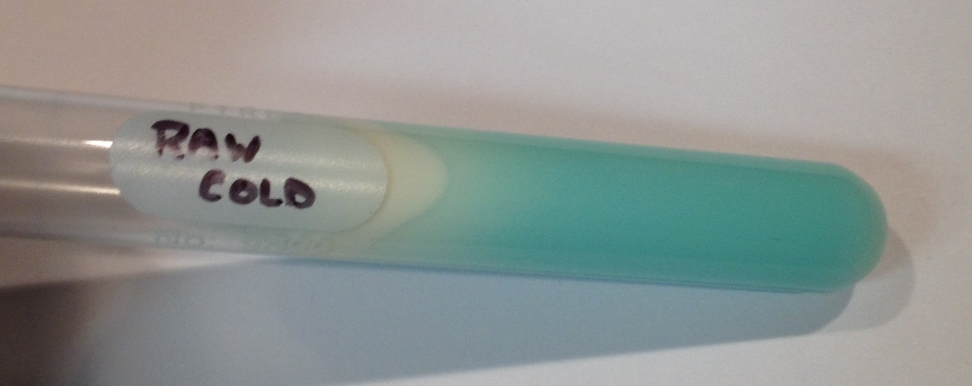
Immediately after the application of methylene blue
Cold raw milk removed from cold storage tank immediately after milking
12 hours at room temperature
24 hours at room temperature
36 hours at room temperature
-sample is still liquid

Slide 21
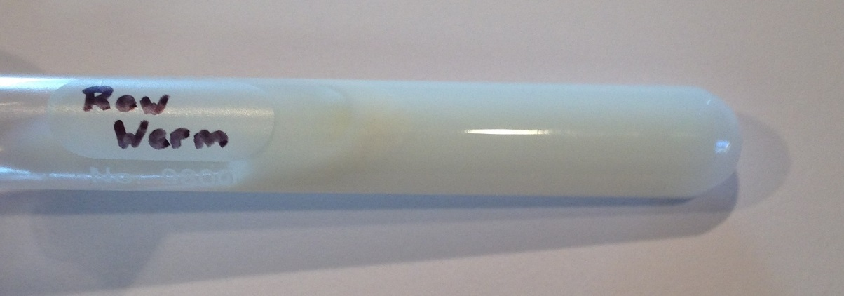
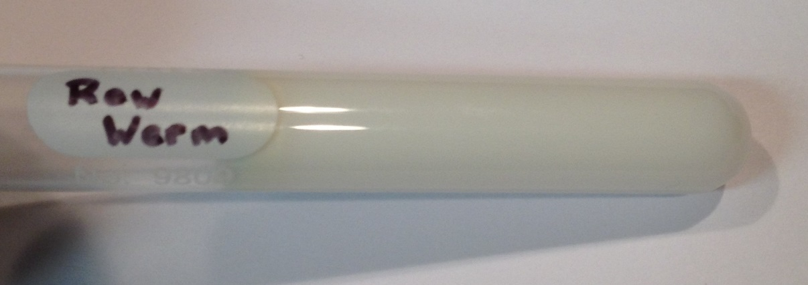
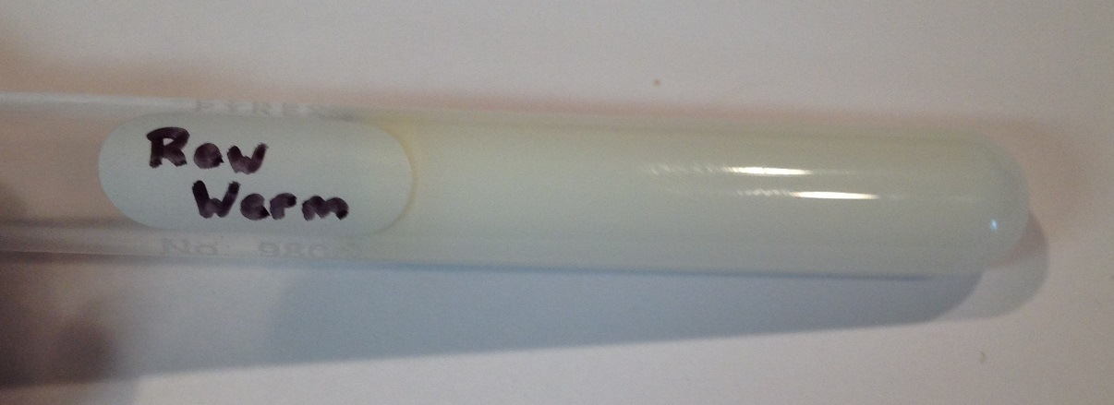
Immediately after the application of methylene blue
Warm raw milk improperly stored at room temperature for 12 hours
12 hours at room temperature
24 hours at room temperature
36 hours at room temperature
-sample is coagulated

Slide 22
Immediately after the application of methylene blue
Cold commercially Pasteurized milk stored at refrigerator temperature
24 hours at room temperature
36 hours at room temperature
48 hours at room temperature

Slide 23
Immediately after the application of methylene blue
Warm commercially pasteurized milk improperly stored at room temperature for 12 hours then re-refrigerated
24 hours at room temperature
36 hours at room temperature
48 hours at room temperature

Slide 24
Immediately after the application of methylene blue
UHT milk Stored at room temperature – sample drawn immediately after opening container
24 hours at room temperature
36 hours at room temperature
48 hours at room temperature

Slide 25
