Slide 1
Today’s Teen Chapter 33
Sewing Equipment

Slide 2
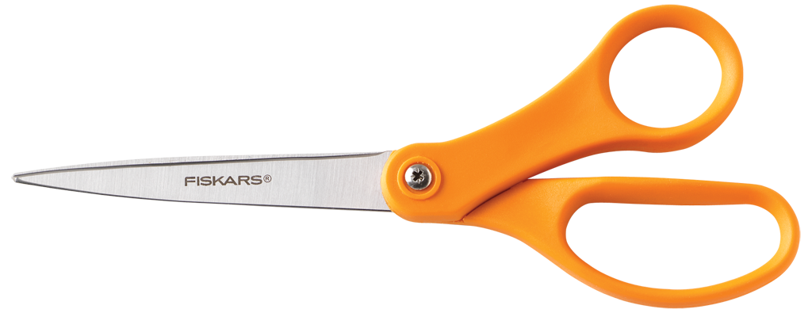
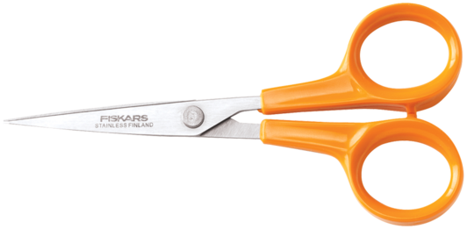
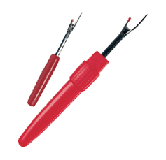
Cutting Equipment
All the pieces of cutting equipment belong to the scissor family. Keep cutting equipment sharp by using it only for sewing. Never cut paper with a sewing scissors. Basic cutting equipment includes.
Small Scissors. Use small scissors to clip threads and trim, or cut off, extra fabric from seams.
Shears. Shears are used for cutting our the fabric. They have long blades with either bent or straight handles. The finger holes on shears are a different shape than those on scissors. Bent-handles shears improve accuracy since the fabric is hardly lifted from the table when it is being cut. Both right- and left-handed shears are available.
Pinking shears. Use pinking shears to finish the edge of a firmly woven fabric or a knit fabric. They help to prevent raveling by cutting a zigzag edge.
Seam Ripper. The seam ripper has a hook-like point. It is handy for cutting and removing stitches.

Slide 3
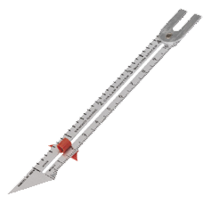
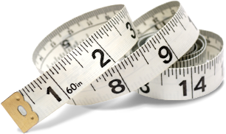
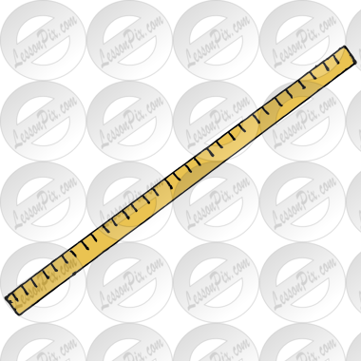
Measuring Equipment
To measure the pattern, fabric, and garment pieces accurately as you sew, the following measuring equipment will be helpful:
Tape Measure. A narrow strip of durable plastic or firm fabric, often marked with both inches and centimeters.
Measuring Stick. A measuring stick, or yardstick, is useful for measuring both the pattern and fabric on a flat surface. Choose one with smooth edges to prevent snagging the fabric.
Seam Gauge. This small ruler has a slide marker that can be set to measure specific lengths. It can be used for measuring small areas, such as hems, buttonholes, and seams.

Slide 4
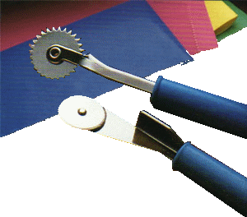
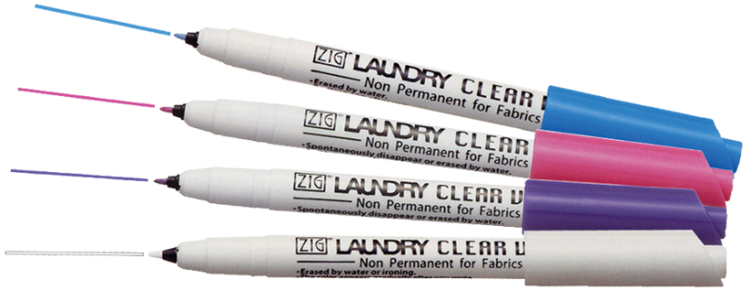
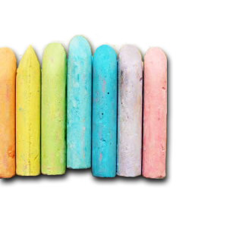
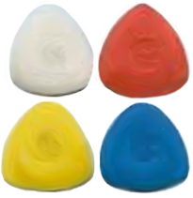
Marking Equipment
Marking equipment will help you transfer important construction markings from your pattern pieces to your fabric. It can be used to mark the correct position of features such as pockets, buttonholes, hems and collars. Here is some of the most common marking equipment:
Tracing Wheel and Paper. A tracing wheel is used with special fabric tracing paper to transfer pattern markings to the wrong side of fabric.
Tailor’s Chalk. Pencils, small squares, or chalk wheels made of chalk or wax are used to mark fabric. Wax is used for wool fabrics. Chalk can be used on all other fabrics.
Fabric marker. This is s special pen that puts markings on fabrics temporarily. Some fabric pen marks can be removed with water. Others fade in a short period of time. It’s best to test fabric markers on a scrap of fabric before using them. Never use markers meant for writing on fabric. The marks may be permanent.

Slide 5
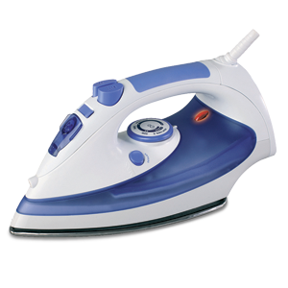
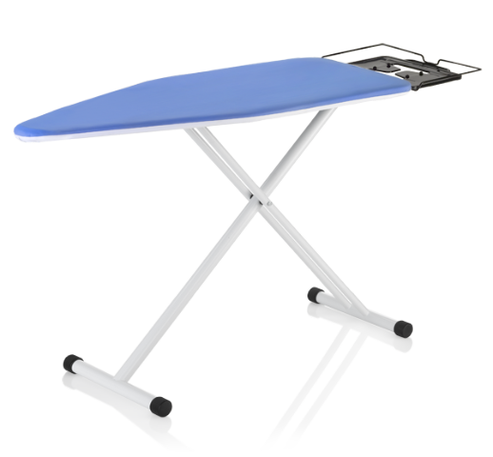
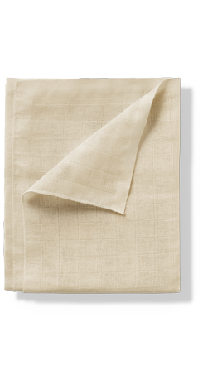
Pressing Equipment
Pressing and ironing can five your clothing a crisp, neat appearance. In addition, pressing your project as you sew will five it a finished and professional look. Basic pressing equipment includes:
Iron and ironing board. A steam iron and a well-padded ironing board are necessary for pressing as you sew.
Press cloth. Use a press cloth between the fabric and iron when pressing helps to keep dark fabrics from developing a shine. You can buy ready-made press cloths, or you can make your own from lightweight muslin or cheesecloth.
Good pressing is done carefully and safely. Pressing equipment gets very hot and can cause injuries if not handled properly.

Slide 6
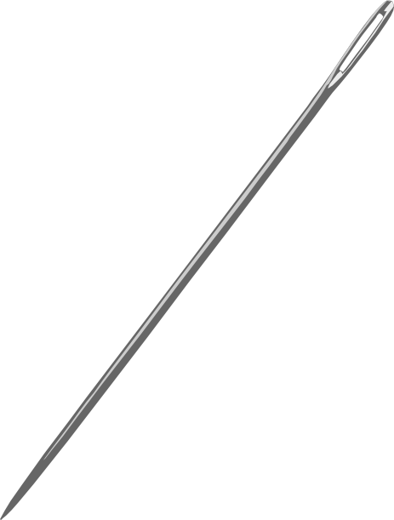
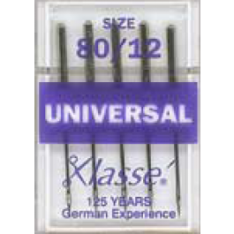
Other Small Equipment
You will need some additional equipment to complete sewing projects.
Hand Sewing Needles. Needles are numbered from 1 (very thick) to 12 (very fine). A sharp point and medium length makes “sharps” best for general hand sewing. Try a size 7 or 8. Ballpoint needles are helpful for knit fabrics. They have rounded points, which separate the knit as you sew.
Machine Needles. Machine needles come in both United States sizes and European sizes. The sizes range from very fine – U.S. size 10 (European size 70) for lightweight fabrics, to U.S. size 14 (European size 90) for medium-weight fabrics, to very coarse – U.S. size 18 (European size 110) for heavyweight fabrics. Select the size best suited to your fabric. Choose ballpoint needles for knit fabrics.

Slide 7
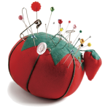
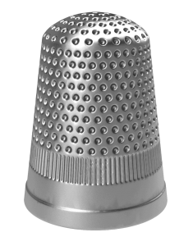
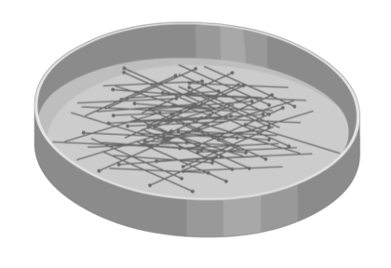
Other Small Equipment continued
Straight pins. Straight pins are used to hold the pattern to the fabric and to hold pieces of fabric together for sewing. Most pins are made from stainless steel. There are sharp pins for woven fabrics and ballpoint pins for knit fabrics.
Pincushion. Use the cushion to keep needles and pins handy while you work. An emery bag, a strawberry shaped bag, is attached to many pincushions. You can clean rusty or sticky needles and pins by pushing them into this bag a few times.
Thimble. A thimble can be used to push a needle through the fabric while hand sewing. A thimble should fit snugly on the third finger of the hand that holds the needle.

Slide 8
Works cited
Information for the slides has be taken from the Today’s Teen text book. This information is for educational purposes only and is not for profit or financial gain.
Kelly-Plate, J., & Eubanks, E. (1997). Sewing Equipment. In Today's teen (5th ed., pp. 367-369). New York: Glencoe McGraw-Hill.
Kelly-Plate, Joan, and Eddye Eubanks. "Sewing Equipment." Today's Teen. 5th ed. New York: Glencoe McGraw-Hill, 1997. 367-369. Print.

