Slide 1
Hands Off, Bacteria
Module 4: Retail and Home
Screen shots have been take from:
Science and Our food Supply Curriculum - Middle School Edition

Slide 2
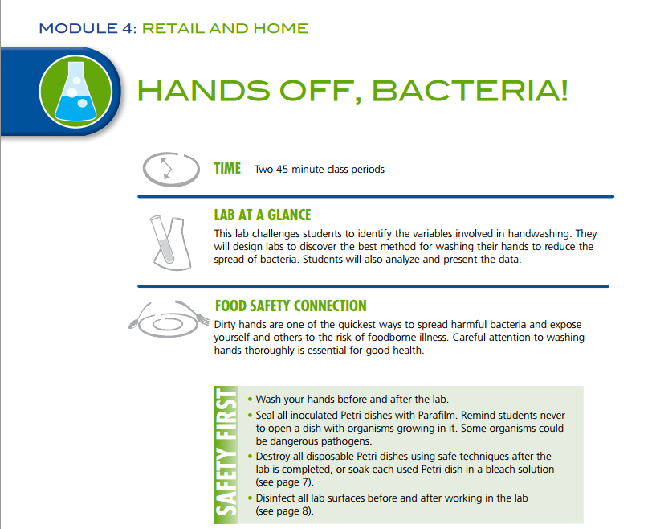

Slide 3
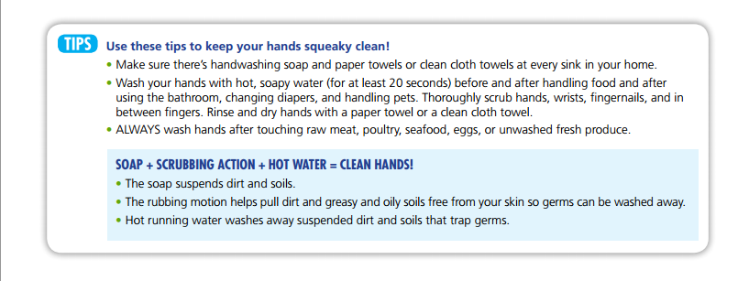

Slide 9
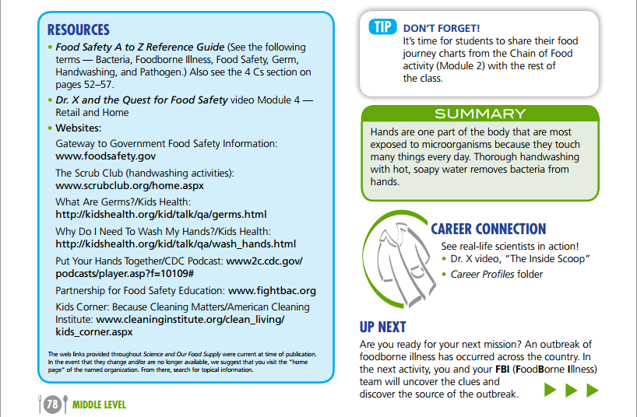

Slide 10
variations
Group Activity
Divide the students into groups and have each group create the perfect set of washing instructions
Apply Glo-Germ and complete the instructions as written
Compare visual results between groups and then review each groups’ directions for effectiveness
Collaborate as a class to write the Ultimate Instructions
Writing Technical Instructions
Have the students each write their own instructions for how to wash hands on a note card
Collect the cards and redistribute to the class
After applying the Glo-Germ – the students wash their hands using ONLY the steps written on their new card
Example – if the card does not say to use water – the student may not use water
Illustrates not only the importance of hand washing, but also clearly written instructions

Slide 11
Standards – Common Core and CTE
Standards: Middle School
6-8.RST.3 Follow precisely a multistep procedure when carrying out experiments, taking measurements, or performing technical tasks
NW 3.1 Explain common practices that promote sanitary food conditions.
Standards: High School
9-12.RST.3 Follow precisely a complex multistep procedure when carrying out experiments, taking measurements, or performing technical tasks attending to special cases or exceptions defined in the text.
NW 2.1 Apply practices to promote safe food handling.
FT 2.1 Determine the steps in the scientific method and demonstrate its use in scientific experimentation.
FT 4.1 Recognize practices and procedures that minimize the risks of food borne illness

Slide 12
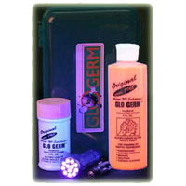
Potential problems
Dry skin – Glo-Germ will ‘soak’ into very dry skin making it very difficult for students to remove no matter how hard they scrub
Neon clothing – can make viewing the results difficult – ensure students hold their hands extended away from their clothing
Staining – orange Glo-Germ can stain clothing, the liquid can also be purchased in a white version
Viewing Area - Purchased kits – like the one pictured – come with a small UV light – purchase a bar black light (or 2) to allow multiple students to view simultaneously
My students love to make this a contest between themselves – who can get their hands the cleanest ☺

Slide 13
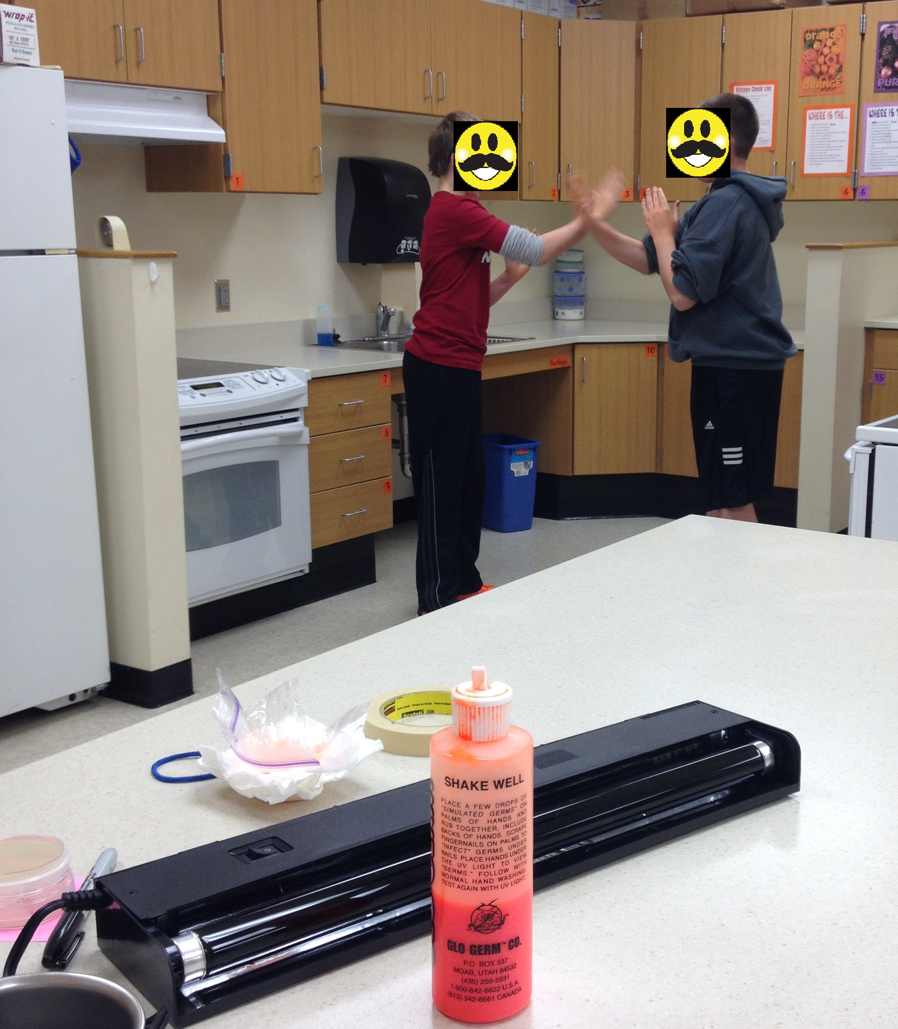
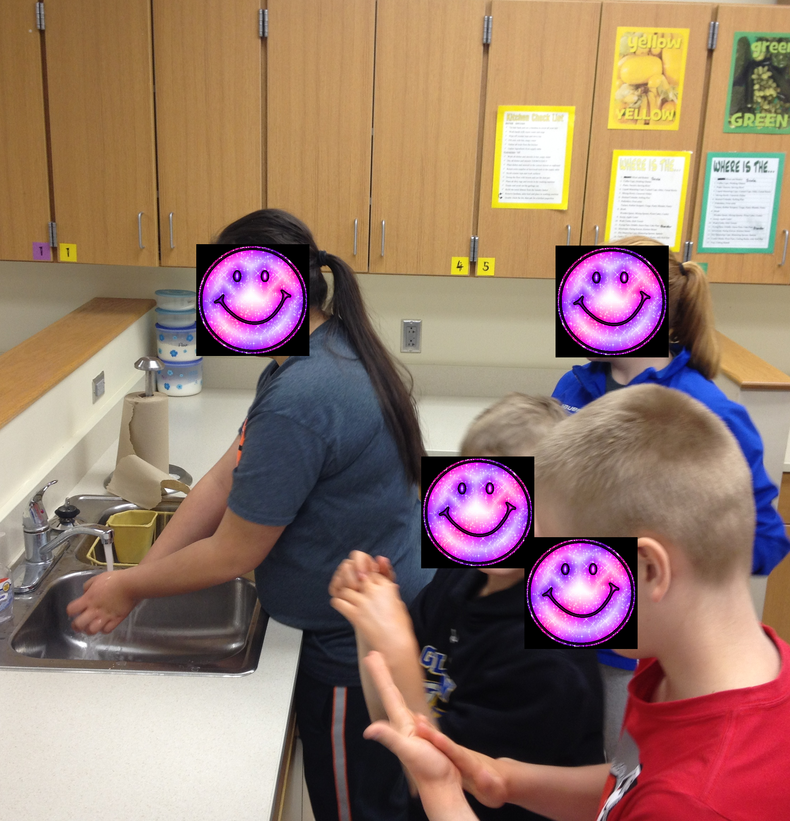
6th Grade students practicing hand washing skills using Glo-Germ as an indicator.

Slide 14
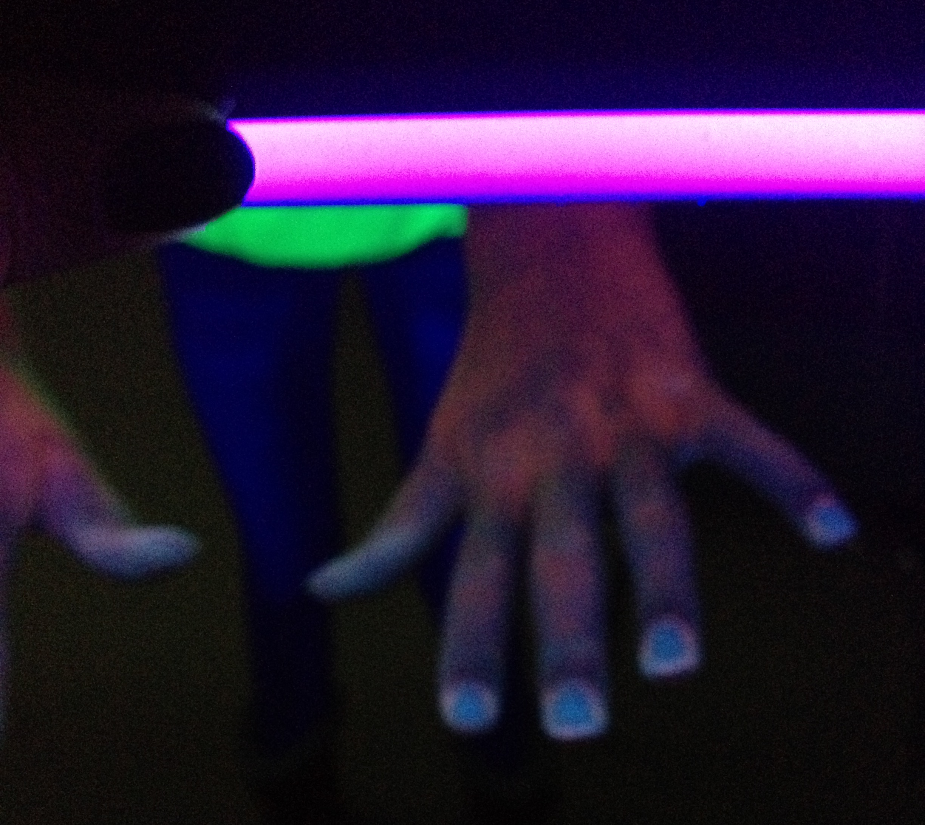
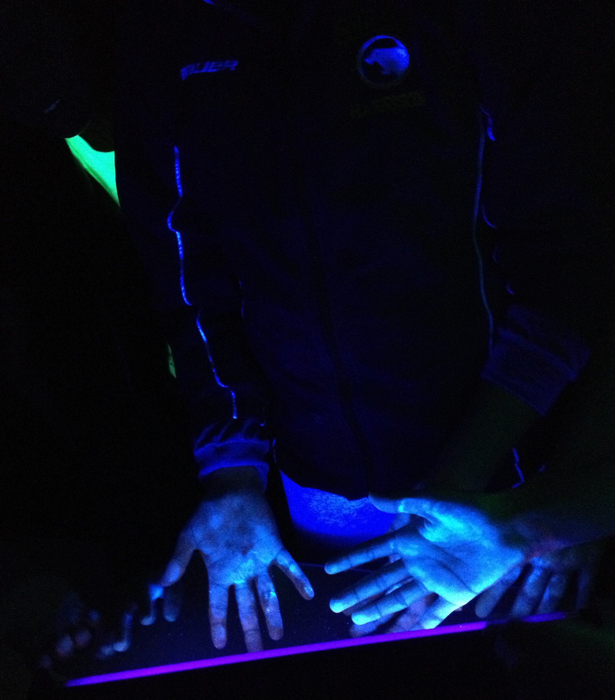
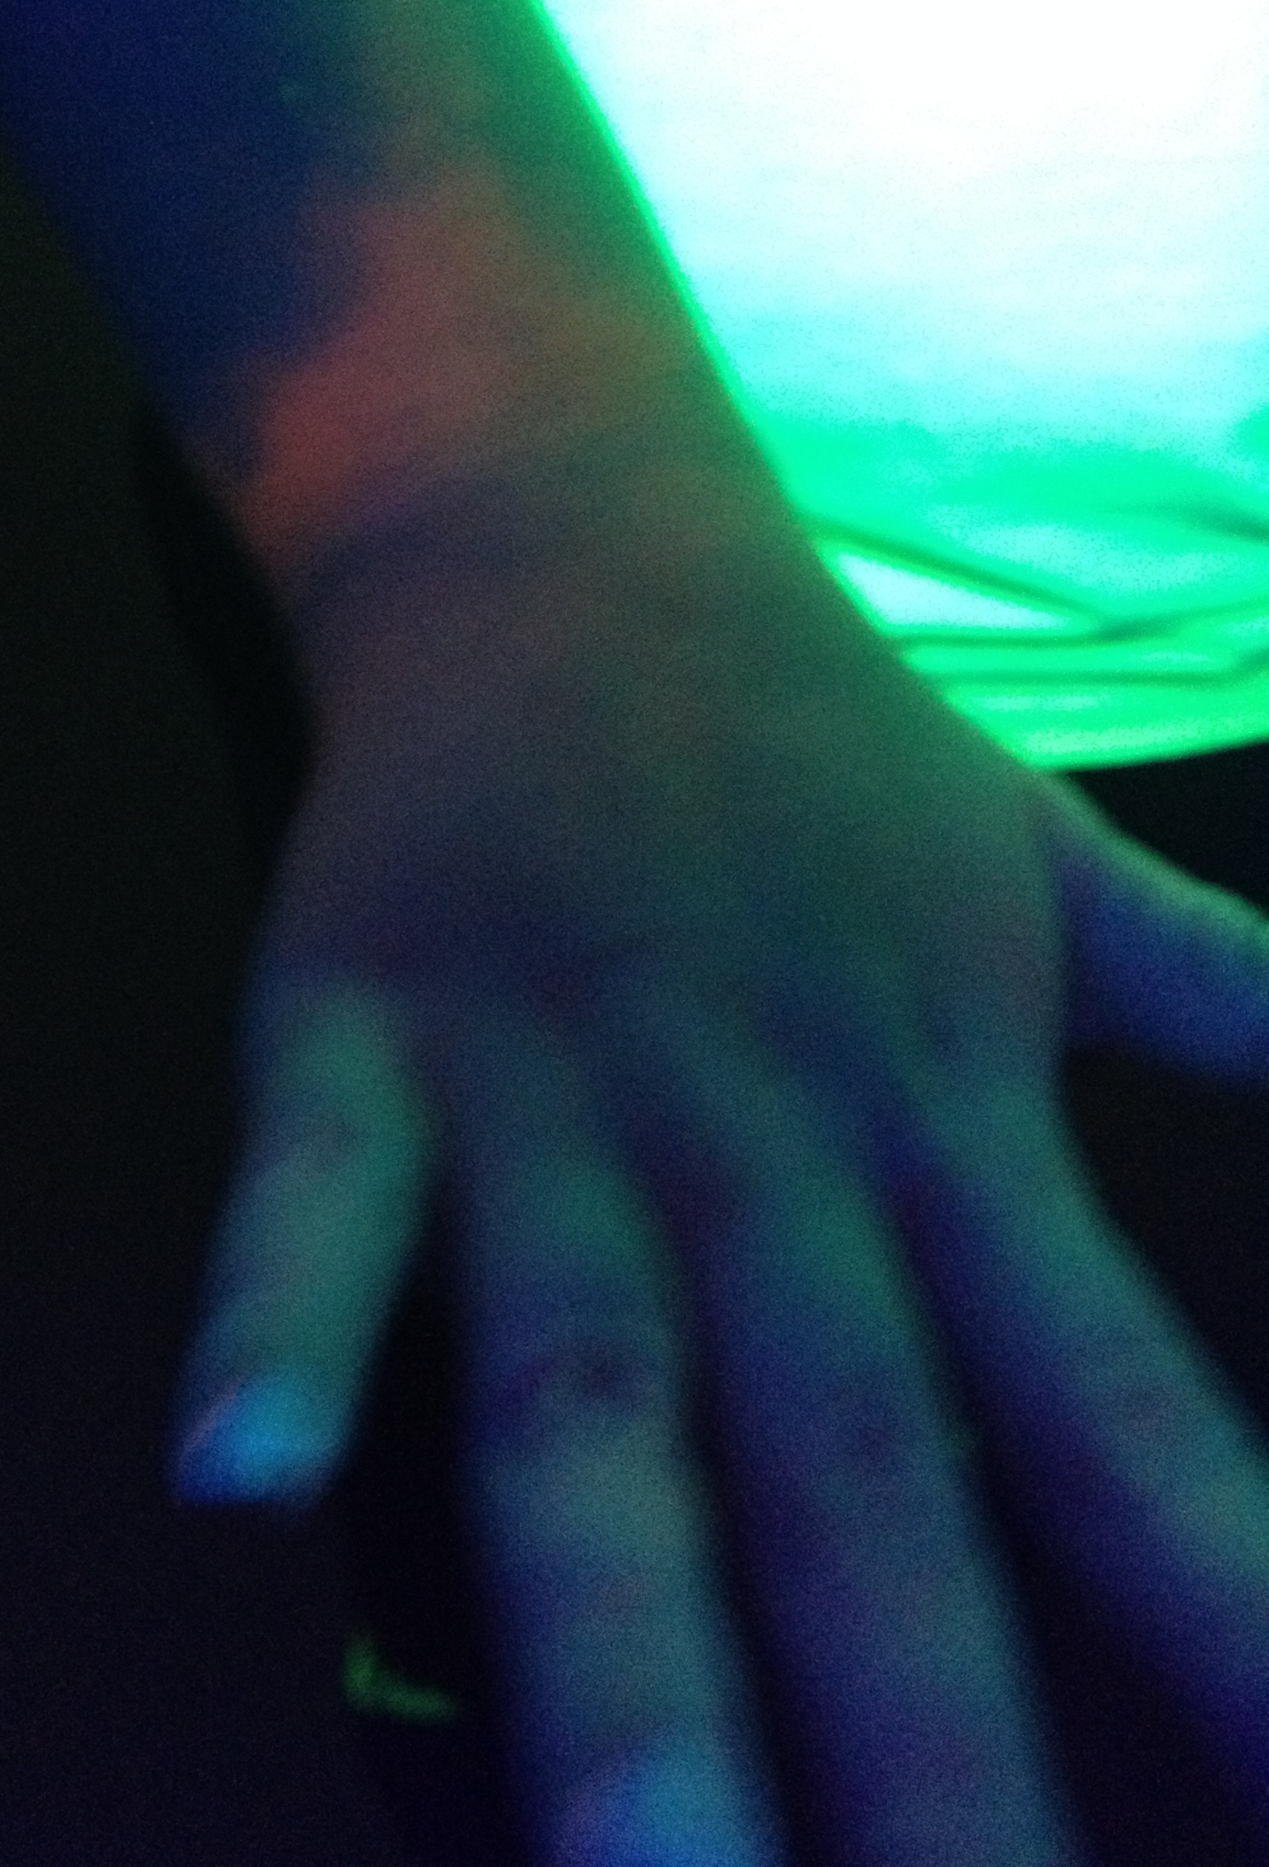
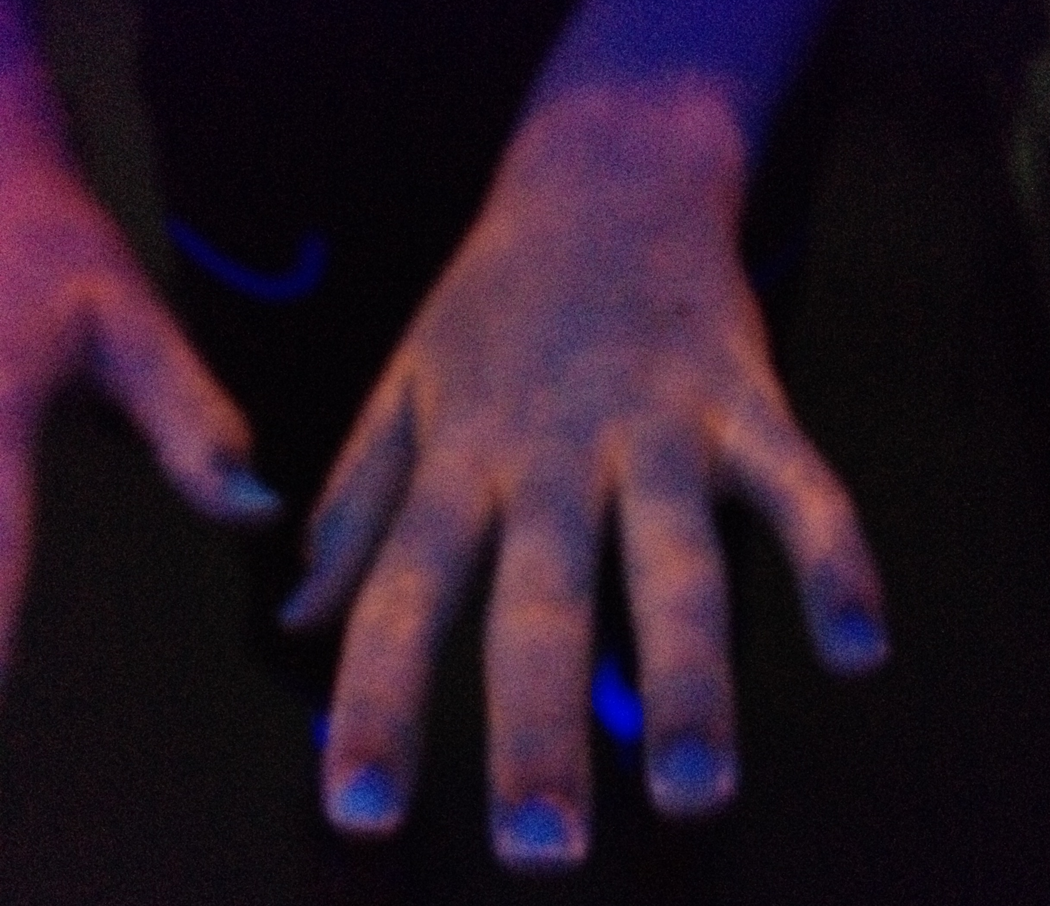
After hand washing – same child as middle top picture
After Glo-Germ oil, but before washing hands
Hand Shaking with Glo-Germ Powder

