Slide 1
Science and Our Food Supply
Us Food and Drug Administration
National Science teachers Association
Graduate School of America

Slide 2
Welcome to Science and Our Food Supply
You and your students are about to experience a unique program that makes food safety an integral part of your curriculum.
Food Safety = Science!
When it comes to making science relevant for your students, what better way than to apply it to something that’s part of their everyday lives? Food gives you an ideal springboard for bringing a host of science concepts to life in your classroom!
Science and Our Food Supply includes timely food safety science that you won’t find anywhere else. It takes the methods of real-life scientists who are working every day to keep our food supply safe — and turns their strategies and goals into hands-on experiences for your own students.
You’ll find in-depth activities and labs covering this broad range of topics:
Bacteria, including Foodborne Pathogens Pasteurization Technology
The Science of Cooking a Hamburger DNA Fingerprinting
Outbreak Analysis

Slide 3
HIGHLIGHTS OF YOUR TEACHER’S GUIDE
What’s Inside . . .
Safety First offers tips and techniques for staying safe in the lab.
Lab Procedures highlights basic procedures for conducting the labs.
Science Content begins each module with a review of the science content presented in the video. Fascinating facts are also featured. Read this section before watching the video module or conducting the activities and labs.

Slide 4
HIGHLIGHTS OF YOUR TEACHER’S GUIDE
Activities and Labs
Activities explore food science concepts and encourage student creativity.
Labs are based on scientific inquiry that explores real-life food science while teaching good scientific methods and lab practices.
Student Sheets are reproducible and accompany several of the activities and labs. A master lab report sheet that students can use for recording their observations, conclusions, and other data is also included.
Resources lists videos, reference books, science supplies, and more. In addition to this listing, check out www.fda.gov/teachsciencewithfood for a multitude of online resources.

Slide 5
Table of contents
Middle School Edition
High School Edition
Module 1: Understanding Bacteria
Science Content in the Video The Big Picture (activity)
Bacteria Everywhere (lab) The 12 Most Unwanted Bacteria (activity)
Module 2: Farm
Science Content in the Video Chain of Food (activity)
Module 3: Processing and Transportation
Science Content in the Video Blue’s the Clue (lab)
Mystery Juice (lab Ultra High Pressure Treatment (activity)
Module 4: Retail and Home
Science Content in the Video Supermarket Smarts (activity)
Cooking Right (lab) A Chilling Investigation (lab)
Crossed Up! (lab) Hands off, Bacteria! (lab)
Module 5: Outbreak and Future Technology
Science Content in the Video Outbreak Alert — Shigella
Beef Blasters (activity) (activity)
Module 1: Understanding Bacteria
Science Content in the Video The Big Picture (activity)
Bacteria Everywhere (lab) The 12 Most Unwanted Bacteria (activity)
Module 2: Farm
Science Content in the Video Chain of Food (activity)
Module 3: Processing and Transportation
Science Content in the Video Blue’s the Clue (lab)
Mystery Juice (lab Ultra High Pressure Treatment Irradiation WebQuest (activity)
Module 4: Retail and Home
Science Content in the Video Fast Food Footwork (activity)
Cooking Right (lab) A Chilling Investigation (lab)
Don’t Cross Me (lab) Instant Replay (lab)
Coliform Counts (lab)
Module 5: Outbreak and Future Technology
Science Content in the Video Outbreak Alert — Salmonella Muenchen Beef Blasters (activity) (activity)

Slide 6
Food Safety Matters!
To Everyone
In 2010, the Centers for Disease Control and Prevention (CDC) presented the following statistics on reported cases of foodborne illnesses in the United States:
48 million gastrointestinal illnesses
128,000 hospitalizations
3,000 deaths
To Students
An awareness of food safety risks is especially critical if your students:
Prepare their own food at home
Prepare food for younger siblings or older relatives/ grandparents
Prepare food for children in their care
Work in restaurants, supermarkets, and other places that sell, handle, and serve food
Learning about food safety will help students better understand decisions and practices that can truly impact their personal health.

Slide 7
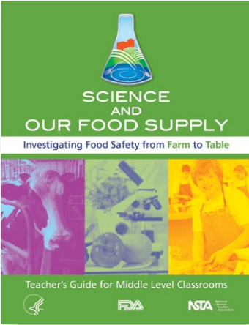
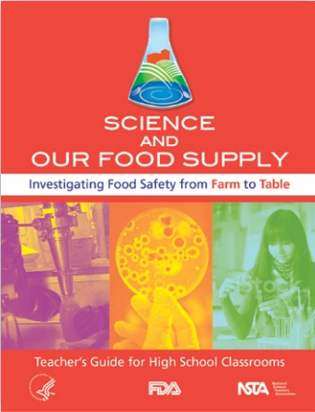
Program components

Slide 8
Science and Our Food Supply Teacher’s Guide
Includes 15 hands-on, minds-on activities and labs
Features fun, creative ways for presenting the lessons
Introduces fascinating facts about food safety

Slide 9
Dr. X and the quest for food safety video
Features a savvy food scientist (Dr. X) and student (Tracy) who introduce and reinforce the science concepts in the activities and labs
Explores behind-the-scenes research in laboratories
Profiles scientists in food safety careers
Provides little-known, pop-up facts
Is also online at www.fda.gov/teachsciencewithfood

Slide 10
Food Safety A to Z Reference guide
Offers the accurate, up-to-date information on food safety
Features an easy-to-use alphabetical format
Includes more than 100 terms and topics
Presents practical, in-depth information on the 4 Cs of Food Safety (Clean, Cook, Chill, and Combat Cross-Contamination)
Introduces healthy practices for handling, preparing, cooking, and serving a variety of foods
Includes a vivid Farm-to-Table Continuum illustration
Showcases interviews with real-life scientists
Includes tips, fun facts, visuals, and answers to your most frequently asked food safety question

Slide 11
Career profiles folder
It's Real-life Science in Action!
So you want to be a scientist?
Learn all about what it takes to make it happen by checking out these exciting interviews! Professionals working in a variety of food safety careers tell all about their jobs, exciting discoveries, and reveal their secrets for success!
Get Inspired!
The packet feature interview highlights from people in a variety of food science careers, plus 5 full-length interviews.
Showcases interviews with real-life scientists
Offers convenient storage for career profiles downloaded from www.fda.gov/teachsciencewithfood

Slide 12
Overview: Activities and Labs

Slide 13
Overview: Activities and Labs

Slide 14
Overview: Activities and Labs

Slide 15
Overview: Activities and Labs

Slide 16
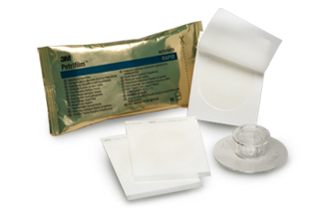
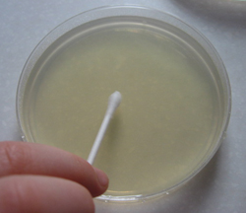
Safety and procedures
VERY IMPORTANT!
Outlines information and Techniques for…
SAFETY
*Preparing the lab *Safety Gloves *Hot Surfaces *Petri Dishes
*Pipettes *Food in the Lab *Proper Clean-up
*Disposal of Used Materials and Equipment
PROCEDURES
*Washing Hands *Disinfecting *Sterilizing Equipment
*Inoculating a Petri Dish (YouTube videos are a great resource for this - https://www.youtube.com/watch?v=C4COfoS8Y6Y)

Slide 17
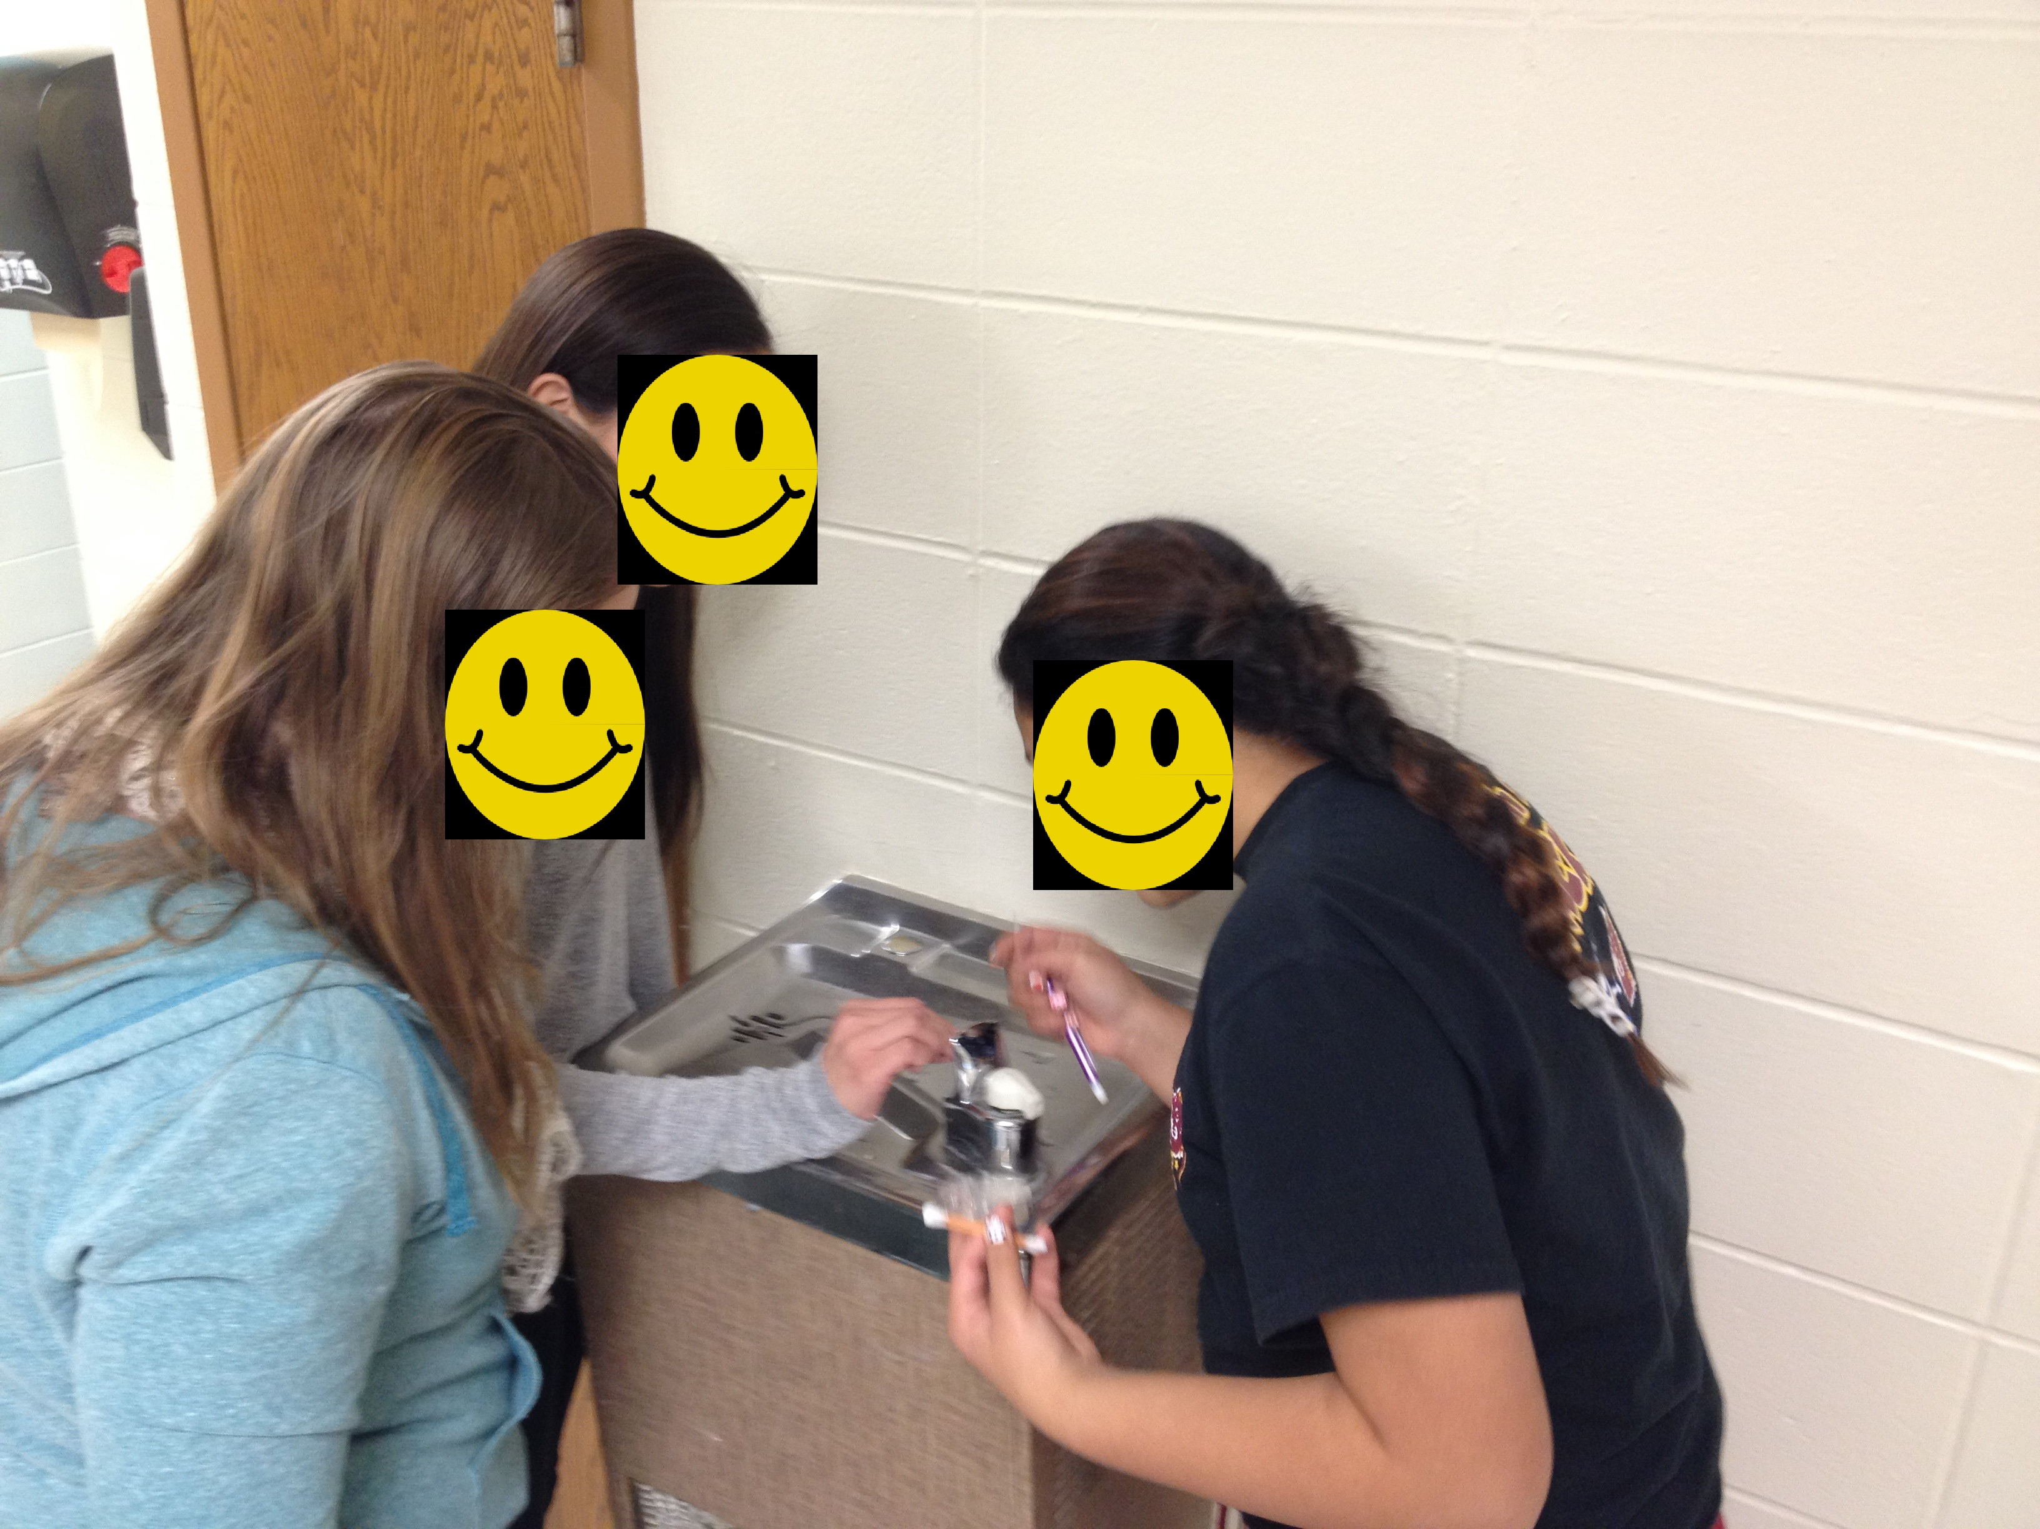
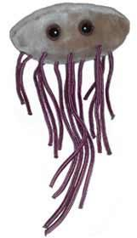
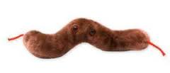
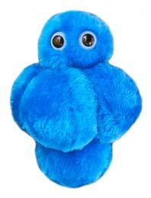
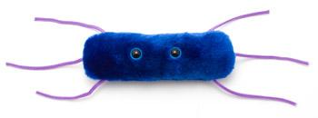
Module 1 – Understanding bacteria
This module lead students into the exciting world of bacteria and food safety
Activities
The Big Picture
Introduces students to food safety
The 12 Most Unwanted Bacteria
Introduces a research project exploring the most common bacteria that cause foodborne illness
Giant Microbes
Labs
Bacteria Everywhere
A lab that shows that bacteria are everywhere and can spread from one surface to the next, potentially contaminating things that come into contact with that food.

Slide 18
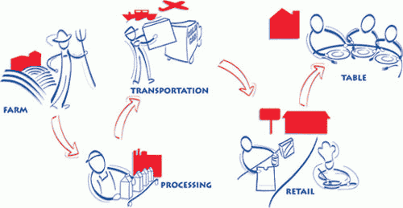
Module 2 – Farm
Who’s responsible for food safety? It’s everyone’s responsibility, from the farmers who grow the food to the people who place the food on your table.
Activities
Chain of Food
Students will explore the path food takes along the Farm-to-Table Continuum and the issues of food safety during processing, transportation, at restaurants and supermarkets, and in their own homes.

Slide 19
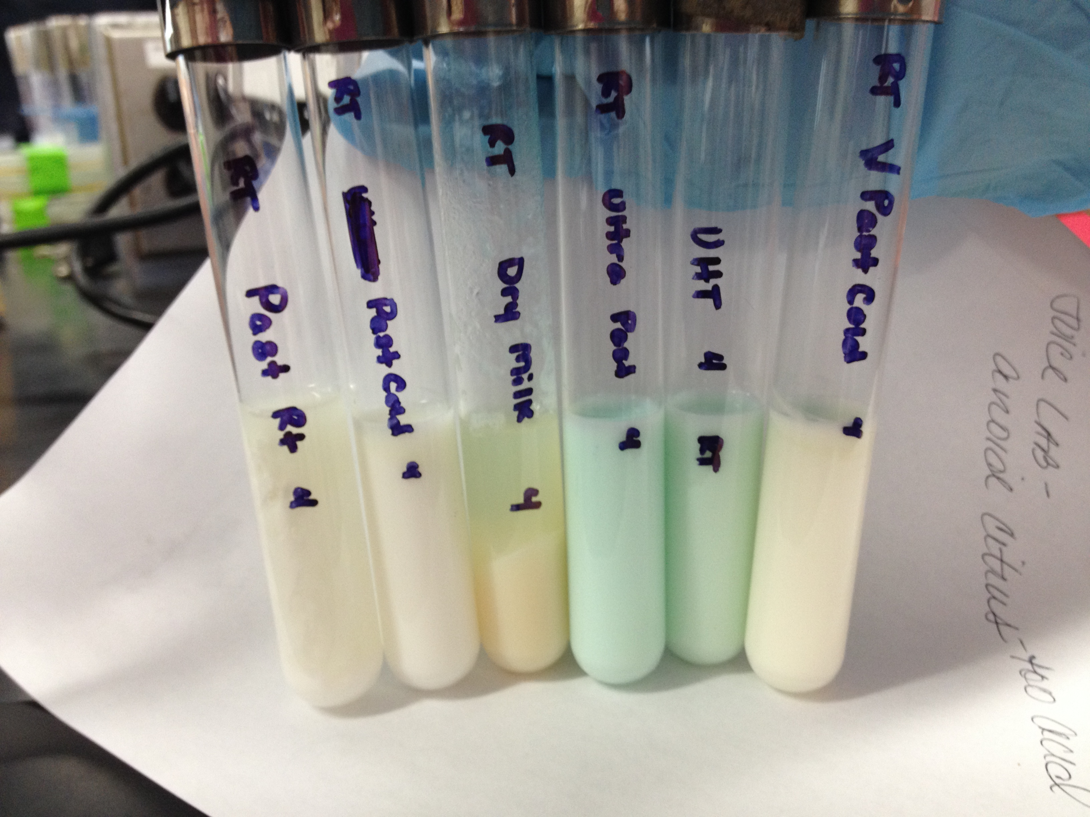
Module 3 – Processing and transportation
This module focuses on several methods scientists used to keep our food safe during processing and transportation.
Activities
Ultra High Pressure Treatment
Shows how foods are kept safe through processing, including one of the newest food preservation technologies
Irradiation Web Quest (High School Edition)
Team research/analysis of irradiation to discover food safety advantages of this procedure
Labs
Blue’s the Clue
Introduces pasteurization and the effect temperature has on reducing and controlling he growth of bacteria
Mystery Juice
Uses investigation to demonstration how pasteurization reduces the number of microorganisms in juice

Slide 20
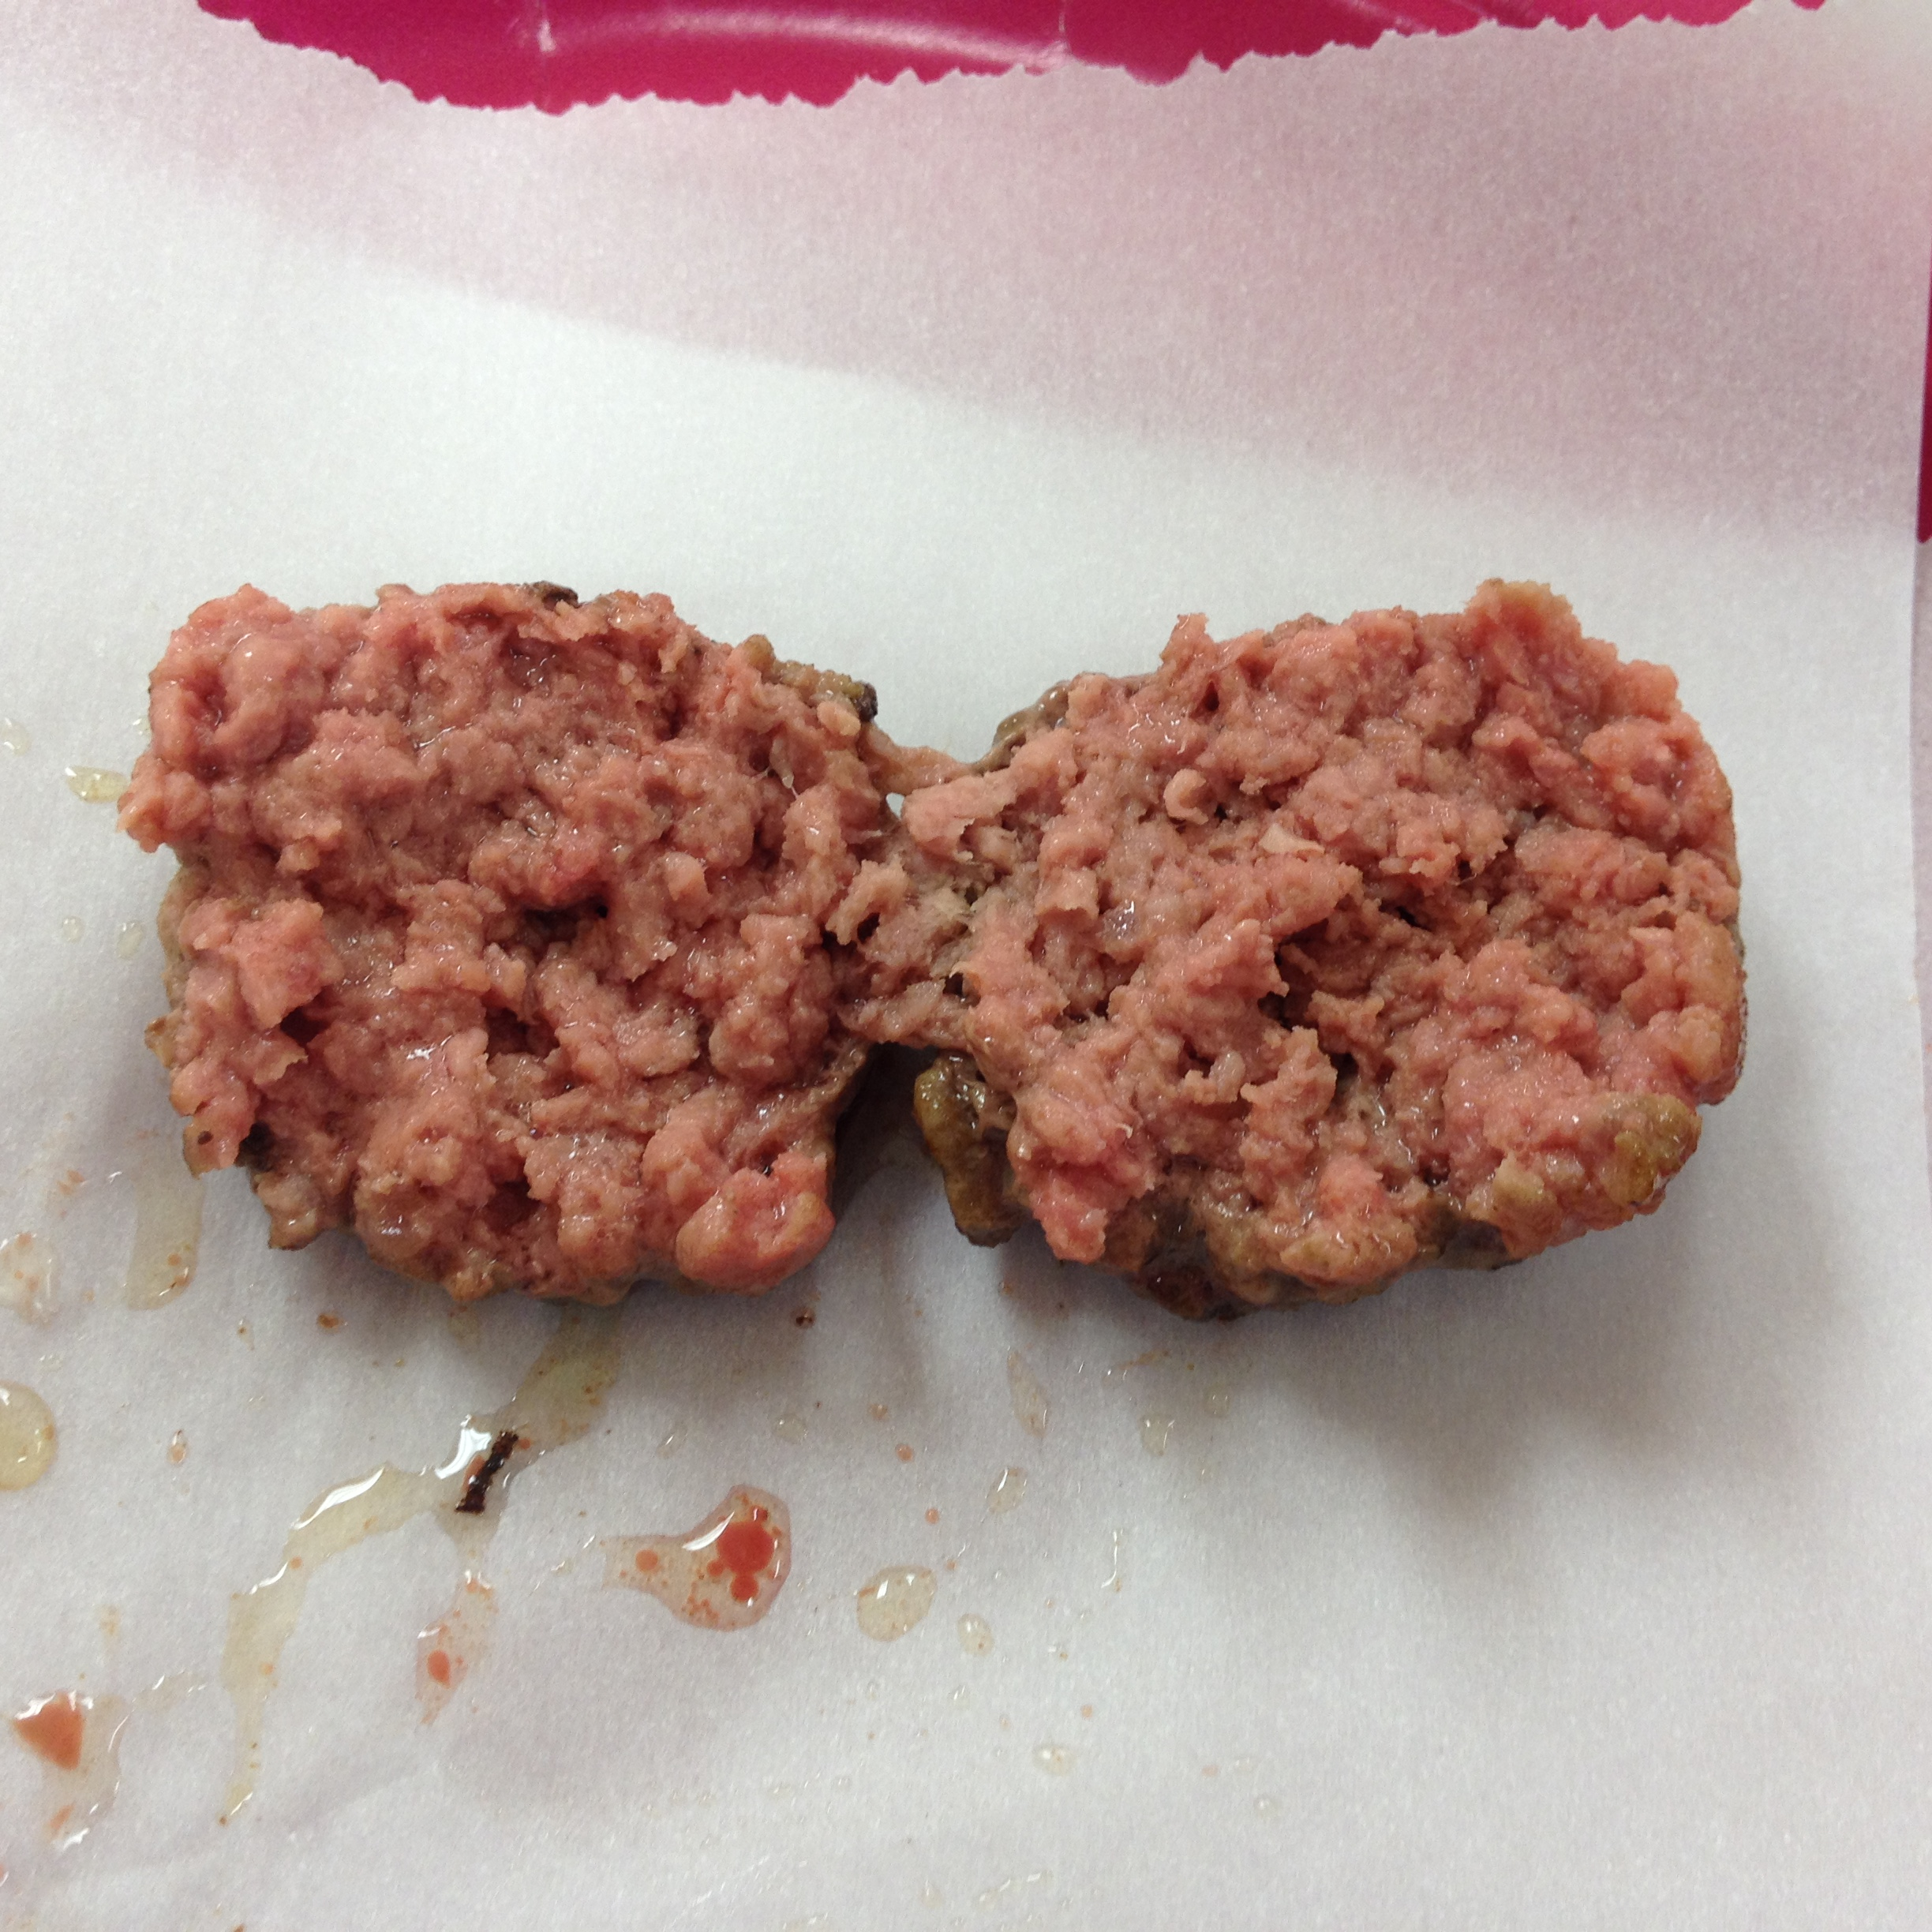
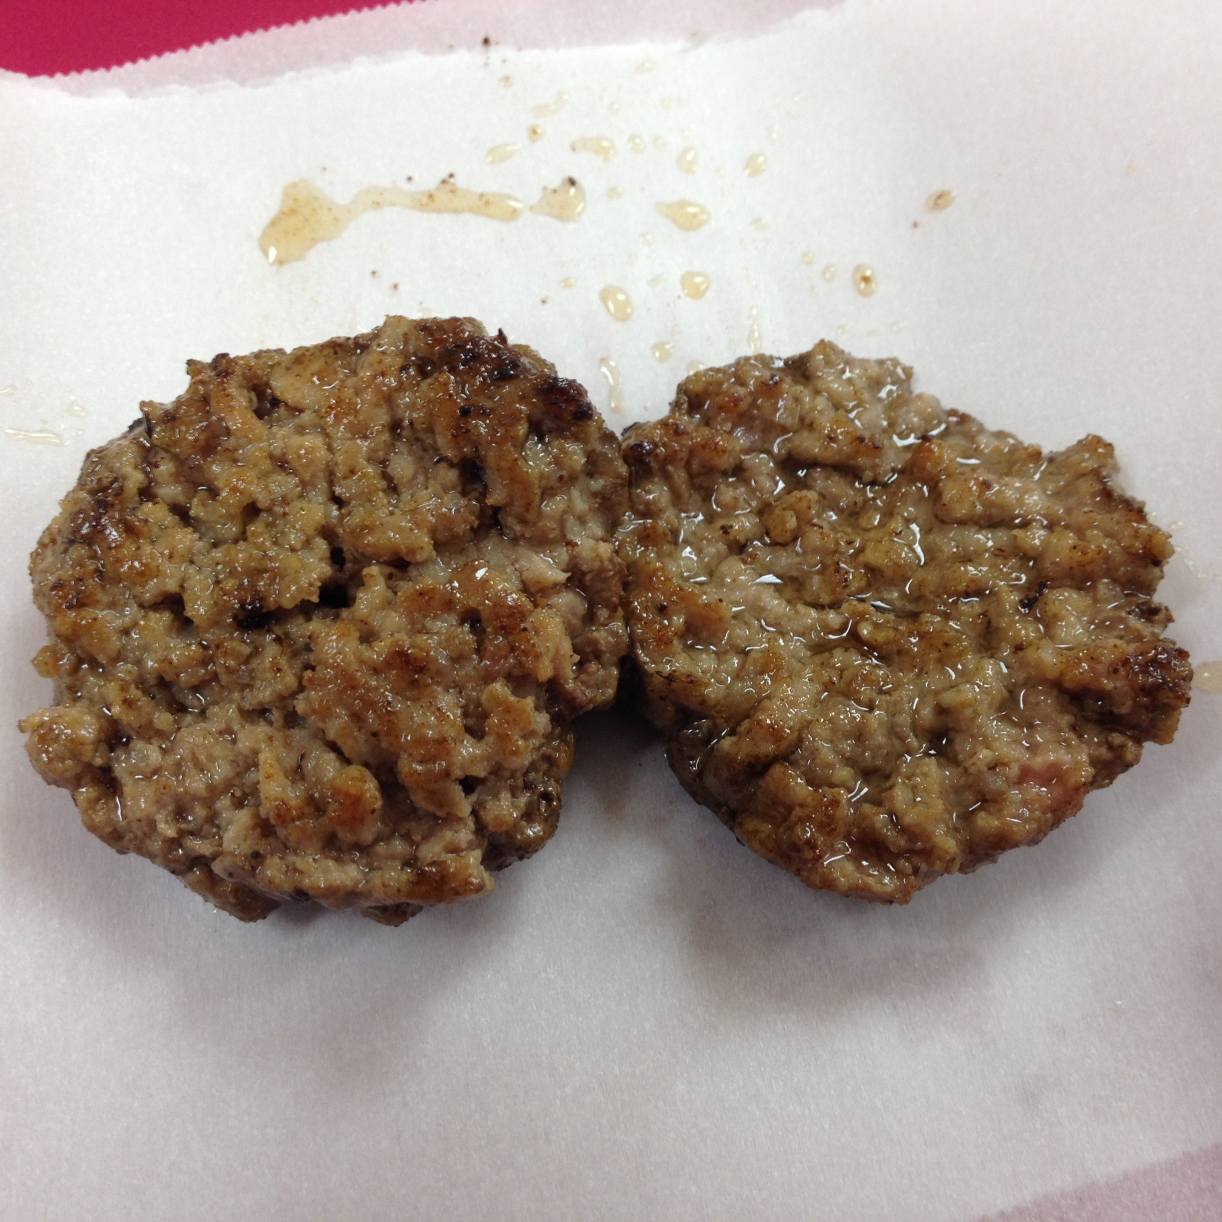
Module 4 – Retail and Home – Middle School
This module examines the preparation of food in retail foodservice establishments and in the home
Activities
Supermarket Smarts
Explores the aspects of safe food handling in a supermarket
Both Burgers temped at 140°F
Labs
Cooking Right: The Science of Cooking a Hamburger
Shows the relationship between the temperature to which a hamburger is cooked and the presence of bacteria
A Chilling Investigation
Investigates the effect of chilling and not chilling on the growth of bacteria
Crossed Up!
Examines how bacteria can be spread among kitchen items in a kitchen if they are not properly cleaned
Hands Off, Bacteria!
Analyzes hand washing and its connection to food safety

Slide 21
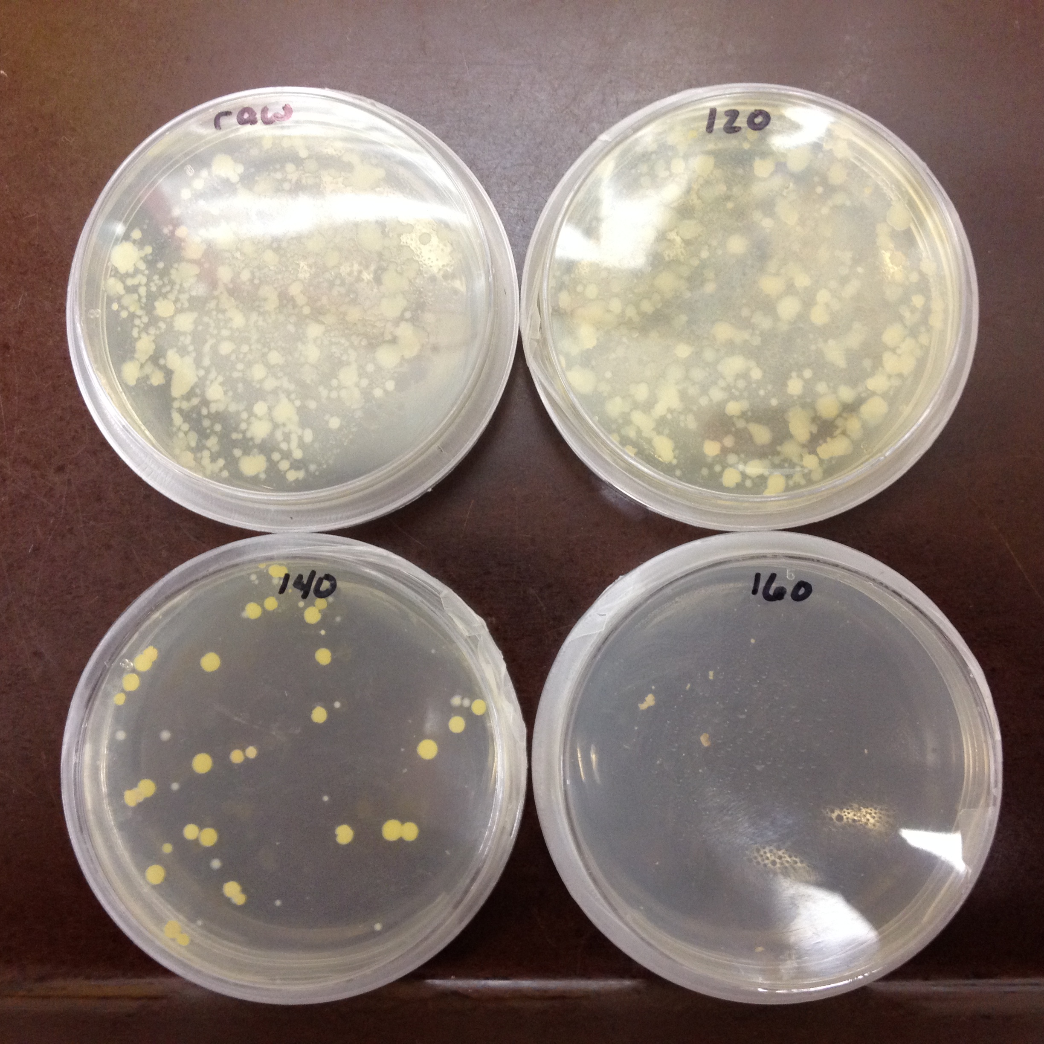
Module 4 – Retail and Home – high School
This module examines the preparation of food in retail foodservice establishments and in the home
Activities
Fast Food Footwork
Explores how retail foodservice establishments ensure that foods is safely stored, prepared and served
Labs
Cooking Right: The Science of Cooking a Hamburger
Explores the 4 Cs of food safety (clean, cook, chill and combat cross-contamination) – through a series of 4 labs
Cooking Right – Temperature Investigation
A Chilling Investigation
Don’t Cross Me
Instant Replay
Coliform Counts
Use a coliform analysis of raw hamburger and fresh spinach, and applies the results to food safety

Slide 22
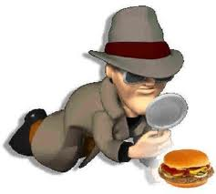
Module 5 – outbreak and future technology
This module takes a look at how technology and unexpected discoveries can benefit us in keeping our food safe.
Activities
Outbreak Alert
Students investigate and outbreak in order to determine its source
Middle School – Shigella
High School – Salmonella Muenchen
Beef Blasters
Explore how one scientist’s experiment led to an unexpected discovery

Slide 23
Evaluation – Loose a Million Bacteria
Built in evaluation tool
Who Wants to be a Millionaire style game
Students generate questions for use during the game.
Premade games using information from the curriculum can be found online
http://www.fda.gov/Food/FoodScienceResearch/ToolsMaterials/ucm2006976.htm

